Slide 1
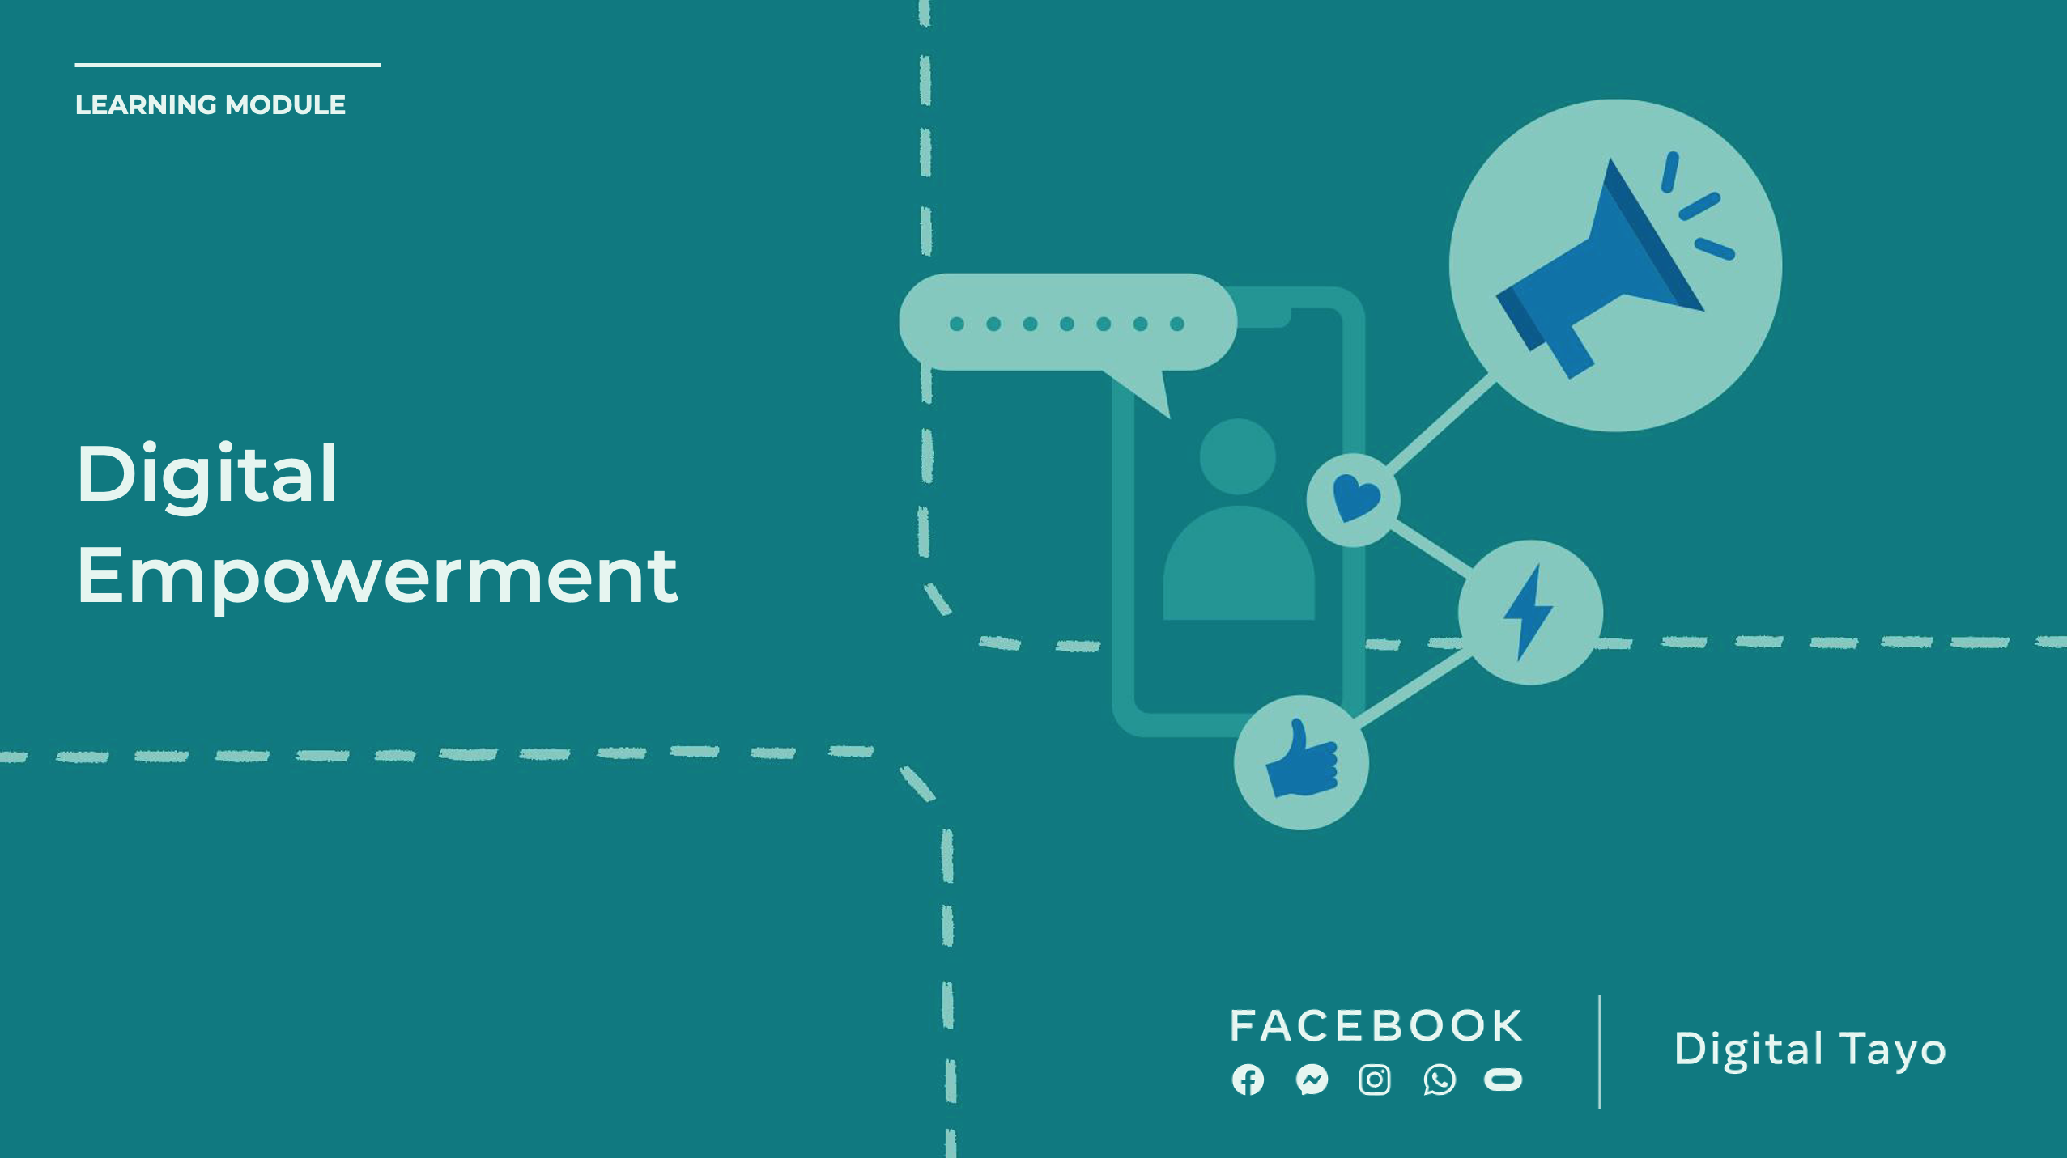
Notes:
Speaker Notes:
The lessons and activities in this section help students participate in public matters and advocate for issues they care about. Skills addressed: civic and political engagement, content production, and law.

Slide 2

Notes:
Speaker Notes:
LESSON OBJECTIVE
Students will learn about the concept of advocacy by identifying an issue that affects their community and brainstorming two changes that they want to see in the future concerning that problem.
ESTIMATED TIME
2 Days and 30 Minutes
ESSENTIAL QUESTIONS
What is a community?
How can you identify and address issues in your community that are important to you?
MATERIALS
Poster Paper
Projector
PREPARATION
Identify a website used for advocacy that your students will be familiar with.
OPTIONAL: ISTE DIGCITCOMMIT COMPETENCY
ENGAGED: I use technology and digital channels for civic engagement, to solve problems, and to be a force for good in both physical and virtual communities.

Slide 3

Notes:
Speaker Notes:
Part 1
TELL YOUR STUDENTS
There are many aspects of our communities and surroundings that we appreciate. Maybe we are grateful for our friends. It could be that we enjoy getting to play on a particular sports team. Perhaps we love having the opportunity to listen to new music from artists we like.
However, sometimes there are aspects about our community that don’t sit well with us. Maybe the school just put a new dress code in place, requiring expensive clothes that we cannot afford. Perhaps an elected politician is trying to create laws that don’t consider our needs. It’s possible that the transportation options where we live are not designed to take us to the places that we need to go.

Slide 4
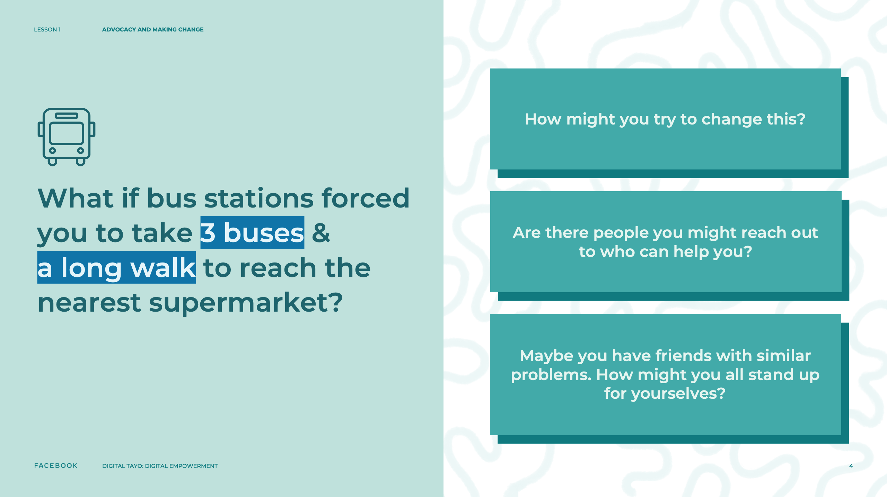
Notes:
Speaker Notes:
TELL YOUR STUDENTS
Let’s say you noticed that the bus stations forced all of you to take three buses and a long walk to reach the nearest supermarket.
ASK YOUR STUDENTS
How might you try to change that?
Are there individuals you might reach out to who can help you?
Maybe you have friends who experience some of the same problems as you. How might you all stand up for yourselves?

Slide 5

Notes:
Speaker Notes:
Part 2
TELL YOUR STUDENTS
In these kinds of situations, we often feel like things might be better if we were able to change what bothers us. This desire to stick up for what you believe in and create change is called “advocacy.”

Slide 6
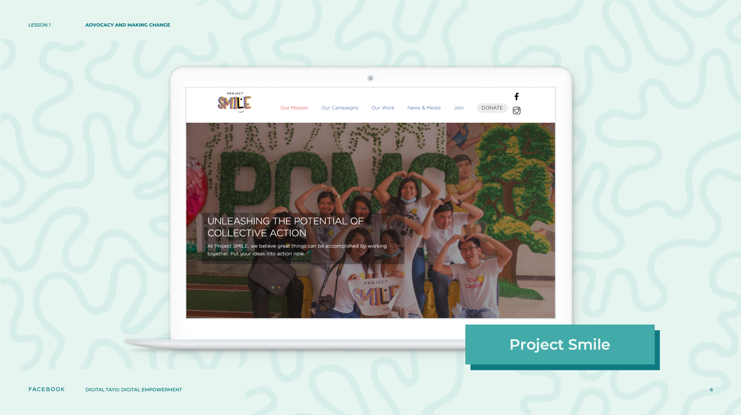
Notes:
Speaker Notes:
CLASS INTERACTION
On a projection screen at the front of the room, review a website used for advocacy. Highlight how the form of advocacy depicted in it began by people, often youth, who realized there was a problem affecting their community and wanted to do something to try to change it. Examples from the Philippines include KRIS (Kristiyano-Islam Library), Project Smile, Save Philippine Seas, and Streets to Schools. Examples that have more of a global scope include Greta Thunberg, Greenpeace, and World Wildlife.

Slide 7
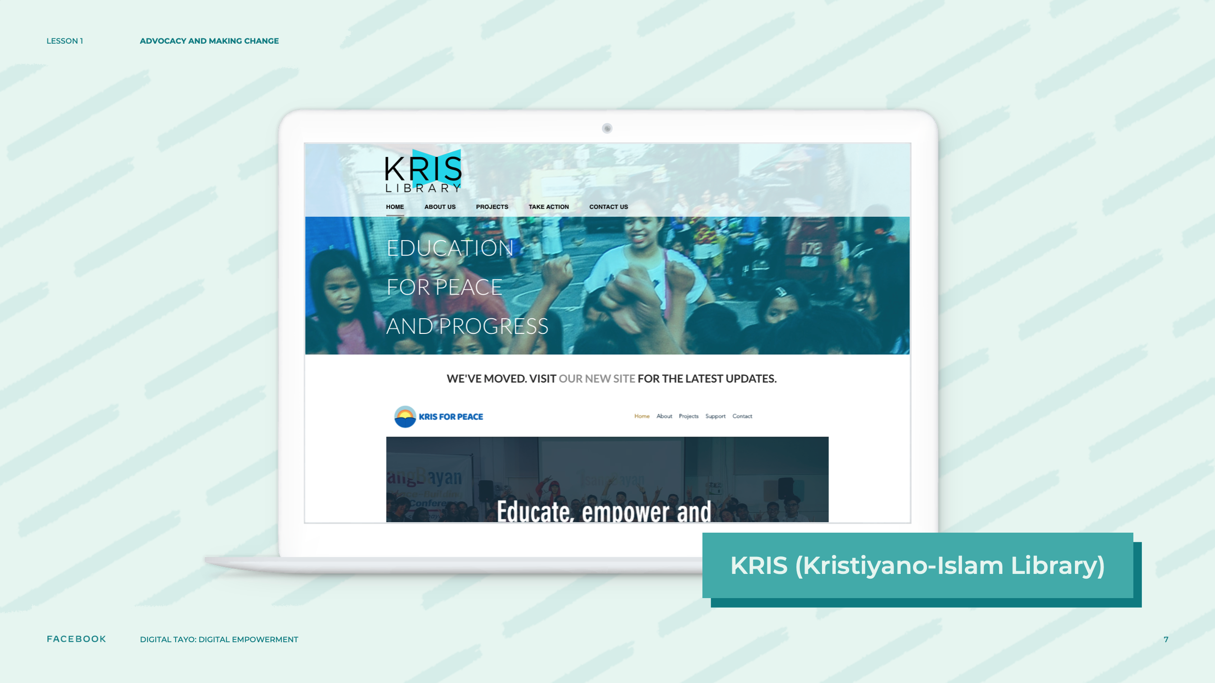
Notes:
Speaker Notes:
CLASS INTERACTION
On a projection screen at the front of the room, review a website used for advocacy. Highlight how the form of advocacy depicted in it began by people, often youth, who realized there was a problem affecting their community and wanted to do something to try to change it. Examples from the Philippines include KRIS (Kristiyano-Islam Library), Project Smile, Save Philippine Seas, and Streets to Schools. Examples that have more of a global scope include Greta Thunberg, Greenpeace, and World Wildlife.

Slide 8
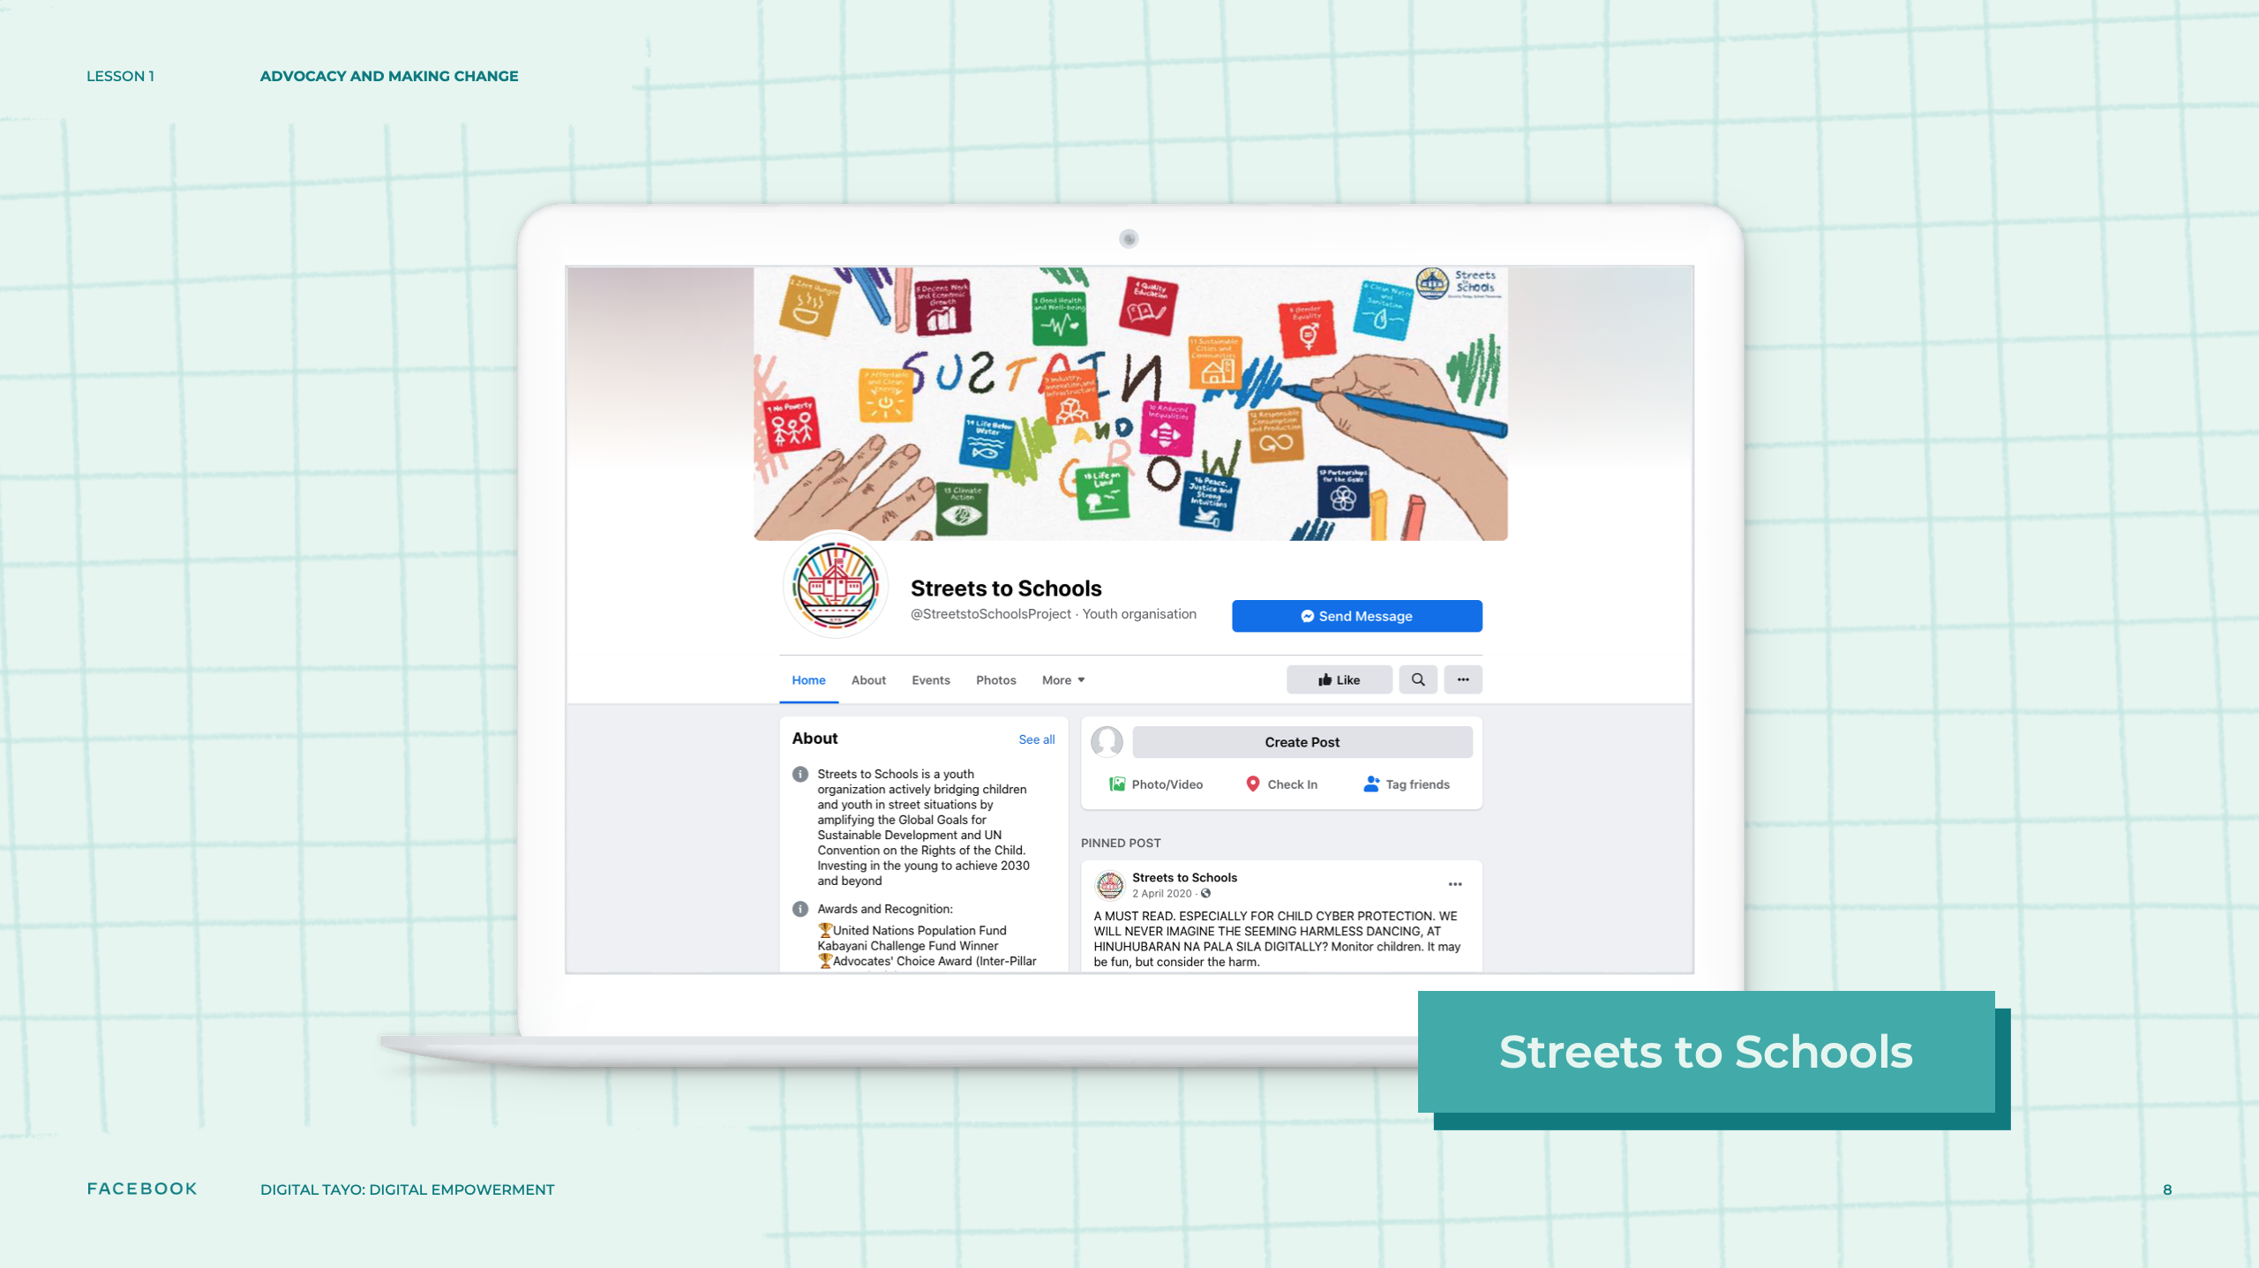
Notes:
Speaker Notes:
CLASS INTERACTION
On a projection screen at the front of the room, review a website used for advocacy. Highlight how the form of advocacy depicted in it began by people, often youth, who realized there was a problem affecting their community and wanted to do something to try to change it. Examples from the Philippines include KRIS (Kristiyano-Islam Library), Project Smile, Save Philippine Seas, and Streets to Schools. Examples that have more of a global scope include Greta Thunberg, Greenpeace, and World Wildlife.

Slide 9
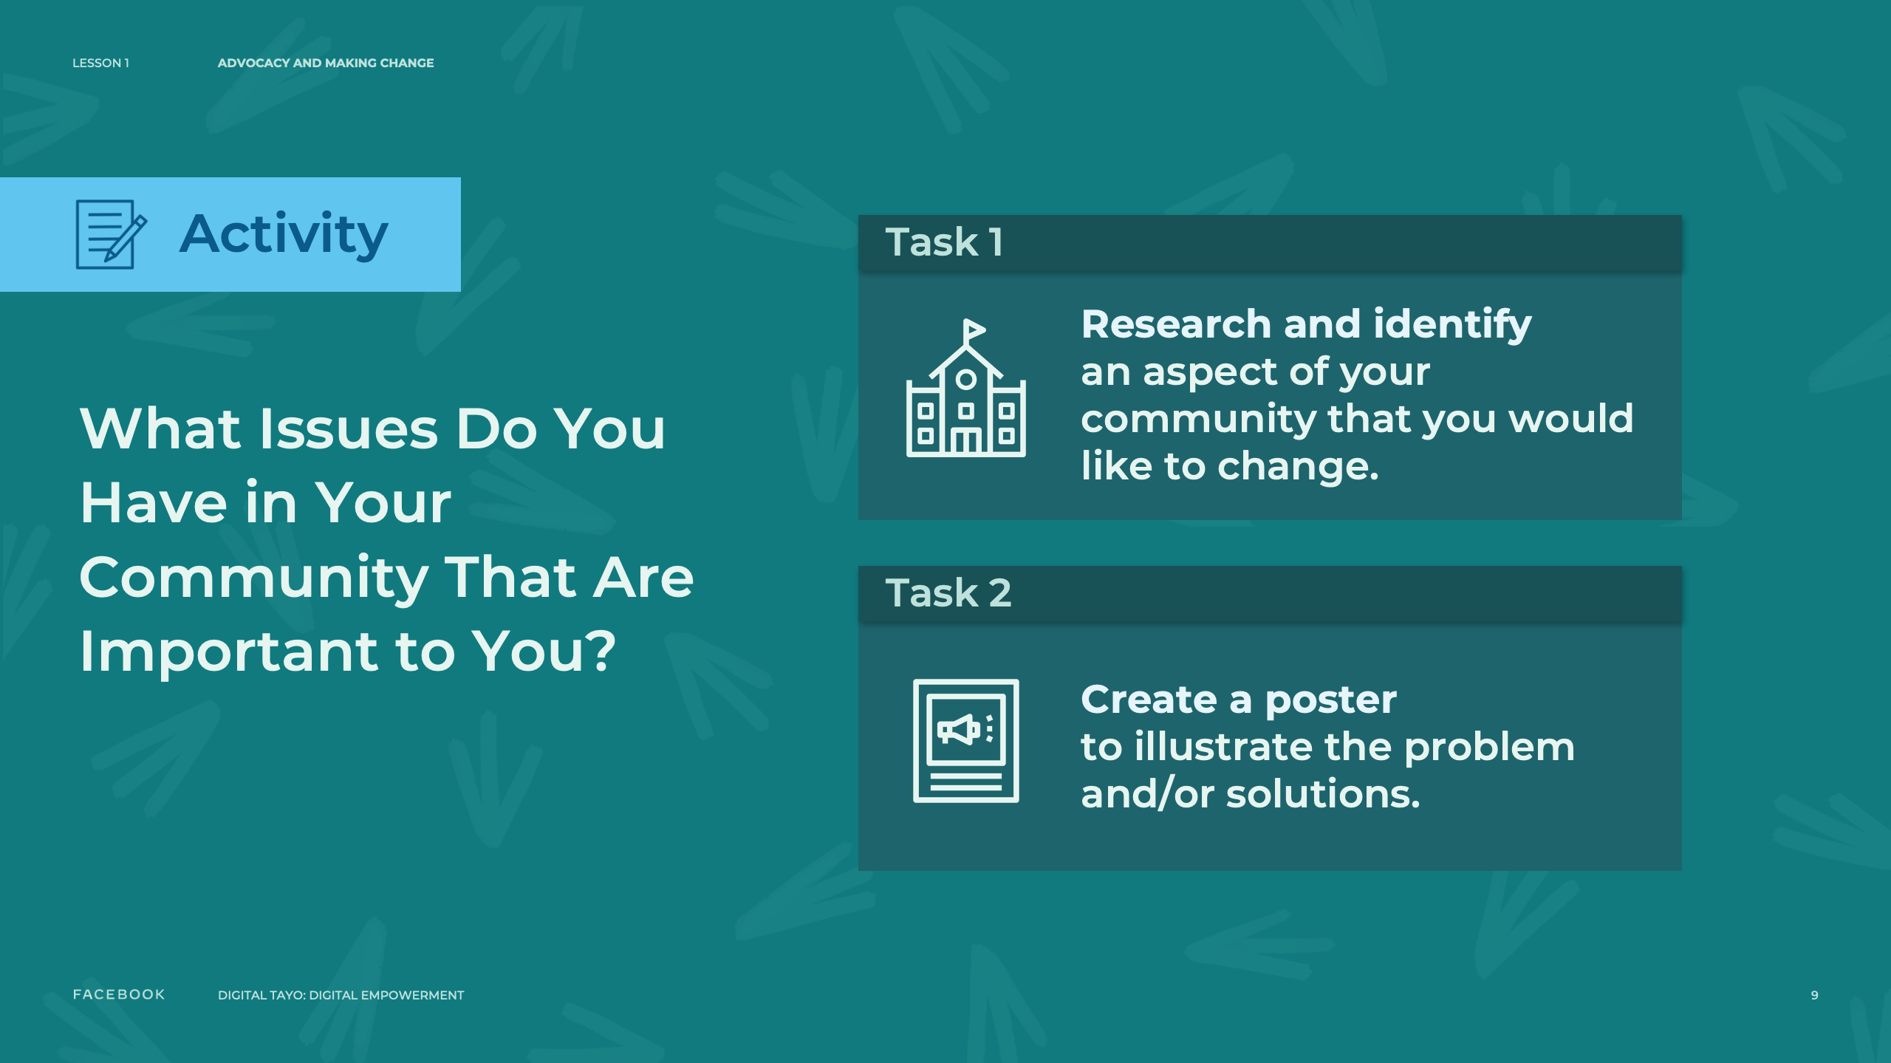
Notes:
Speaker Notes:
TELL YOUR STUDENTS
Now we are going to identify one issue in your community that you’re passionate about and some next steps you and the community might take to solve a problem.
ASSIGNMENT
Split students into groups of three. Give each group time in the current session and at least two full days to 1) research a problem impacting their community, identifying at least two ways the issue is affecting their community and two ways to potentially solve the problem, and 2) develop a poster that provides information on the identified issue and potential solutions that they will present to the larger group as part of a “gallery walk.”
TELL YOUR STUDENTS
In your groups:
Research and identify an aspect of your community (a “community” could be your school, neighborhood, or a local group you belong to) that you would like to change. You can talk to your friends, teachers, and/or family about things they would like to change or about the problems affecting them.
Create a poster. The posters created by each group will be hung on the wall and we will do a “gallery walk” together where each group will discuss the problem they identified and how to solve it.
Each group must identify at least two ways the issue is affecting their community and two potential ways to solve it.
Be creative: Take photos and paste them onto the poster (ideally, make sure students have access to a printer) to illustrate the problem and/or the solutions or use flowcharts, graphs, and charts to communicate the extent of the problem and/or the solutions.
Each poster should “stand alone” — in other words, the poster should have enough information on it so that someone can view/read it and understand the issue and potential solutions without a group member’s explanation.
ASSIGNMENT
Give each group enough time to engage in research and develop their posters. Make sure that you are available for questions and technical support. When the larger group reconvenes, have students hang the posters on the wall, give the larger group 20 minutes to walk around and look at others’ posters, then allow about 30 minutes to have each smaller group present their poster to the larger group.

Slide 10
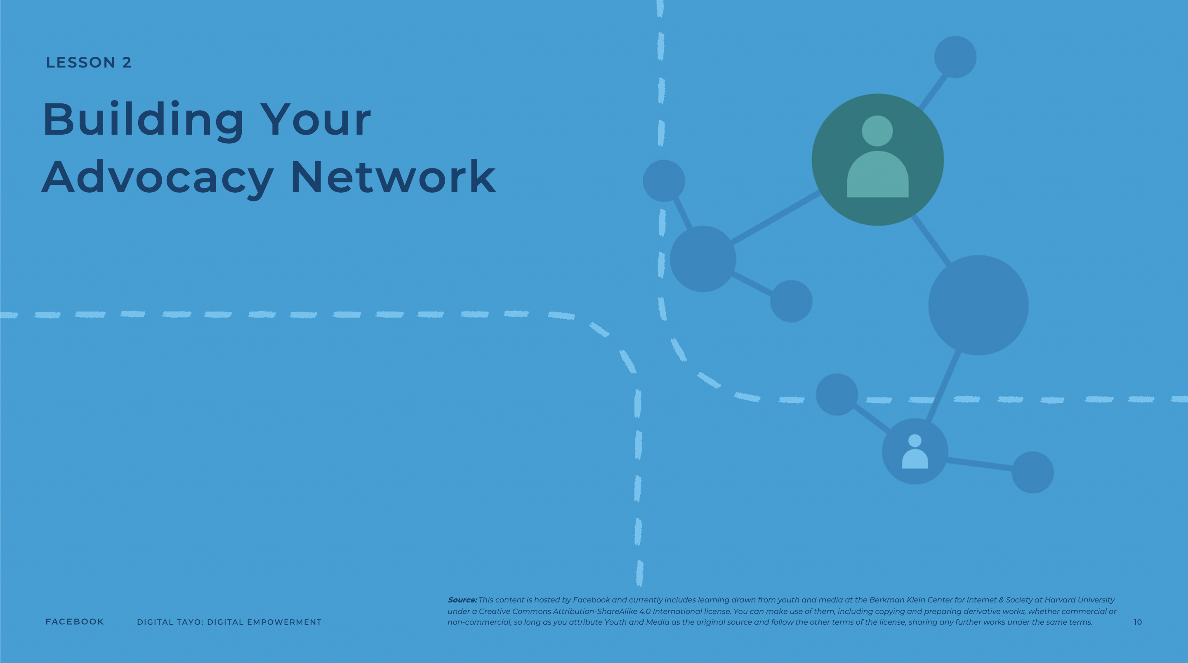
Notes:
Speaker Notes:
LESSON OBJECTIVE
Students will learn how social networks can be leveraged to promote advocacy efforts. Students will also learn how to develop online content to spread information about a cause of interest.
ESTIMATED TIME
1 Hour
ESSENTIAL QUESTION
What is the power of networks in advocacy efforts?
MATERIALS
Projector
PREPARATION
Identify a video to demonstrate social connection relevant to your community.
Students need internet access to complete this lesson.
OPTIONAL: ISTE DIGCITCOMMIT COMPETENCY
ENGAGED: I use technology and digital channels for civic engagement, to solve problems, and to be a force for good in both physical and virtual communities.

Slide 11

Notes:
Speaker Notes:
Using Human Social Networks for Advocacy
Part 1
TELL YOUR STUDENTS
There is a famous phrase that says, “It isn’t what you know. It is who you know.” While this isn’t 100% accurate (what you know is also incredibly important!), it is a helpful reminder of the importance of networks.
Whether you are looking for a job or trying to play sports at the next level, having a good network can allow you to make contacts who can help you achieve your goals. Advocacy efforts are no different. The bigger and better the network of people we know, the easier it will be to create change in our communities.
From our family members and friends to our teachers and community leaders, we already know more people than we think, especially when we include friends of friends and extend our network beyond those closest to us. These individuals can be great resources for reaching our goals.
There are many people we might not know yet who can help us achieve our goals. Social media and the internet more broadly present other ways of meeting the kinds of individuals who might contribute skills or resources to our advocacy efforts.

Slide 12
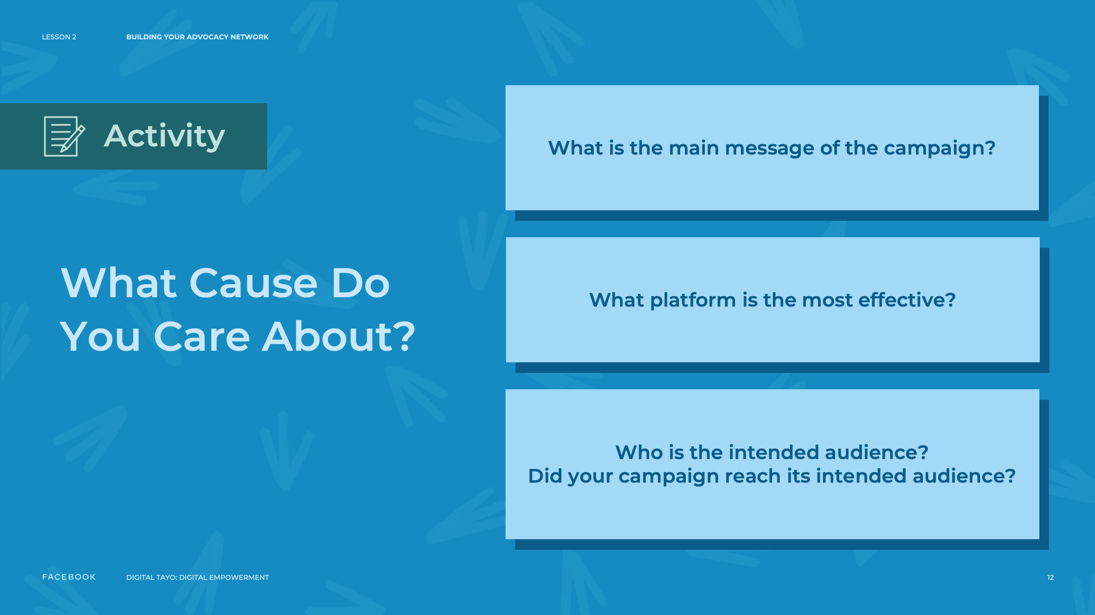
Notes:
Speaker Notes:
Part 2
VIDEO
On a projection screen at the front of the room, show a video example aligned with your/students’ local/regional context to showcase how people are connected through social networks and how we can benefit from these connections.
ASK YOUR STUDENTS
How might information be spread effectively through your existing social networks? How can we use these connections to promote advocacy efforts?
TELL YOUR STUDENTS
In the following activity, you will create a shareable online resource that describes the cause that you care about.
By sharing your advocacy efforts online, you can tell others about what you care about and potentially meet new people who may be able to assist your efforts!
ASSIGNMENT
TELL YOUR STUDENTS
Create a shareable online resource (e.g., using Google Docs, a social media platform, a Wordpress blog, a website on Neocities, a slide presentation using Scratch) about an issue you care about, where you will: Write an introduction explaining the cause and why you believe it’s important.
Provide links for several websites (e.g., an online article) dedicated to the issue.
List three people who write, blog, tweet, or make digital media content about this area. (Optional: If you can, write a tweet to each of these individuals and tell them about your cause and what you would like to achieve.)
CLASS INTERACTION
Give students 30 minutes to complete the activity. Depending on the time allotted, in the current or the second group convening, ask students to share their resources with the larger group and have a 15-minute discussion highlighting effective strategies.
TEACHER’S NOTE
When discussing effective strategies with your class, make sure they are considering the following:
What is the main message of the advocacy/campaign?
What platform is the most effective in the campaign?
Who is the intended audience? Did the campaign reach its intended audience?

Slide 13
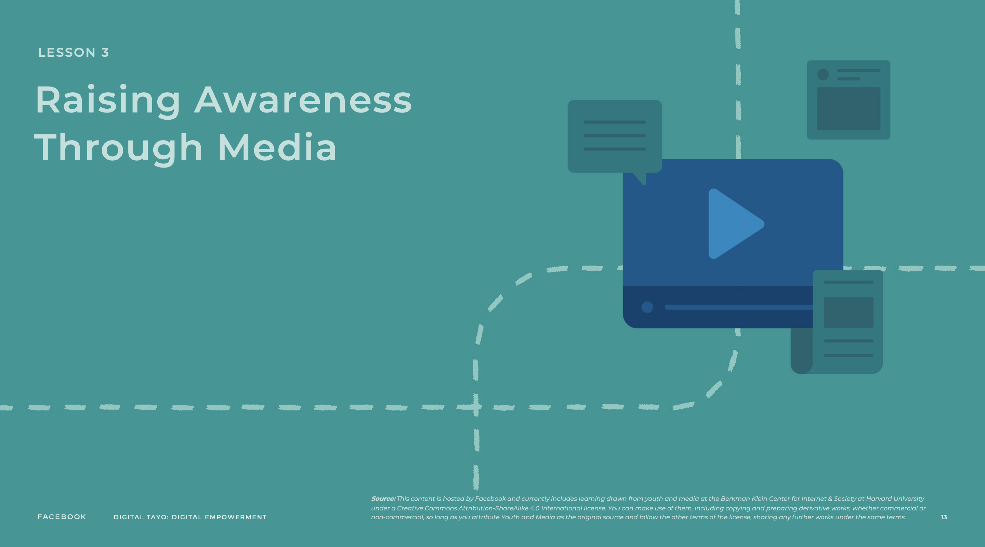
Notes:
Speaker Notes:
LESSON OBJECTIVE
Students will learn about and identify ways in which various types of media can be used to promote awareness around an issue.
ESTIMATED TIME
1 Hour and 5 Minutes
ESSENTIAL QUESTION
How can digital media promote awareness around an issue?
MATERIALS
Projector
PREPARATION
Identify a video to demonstrate how media can be used to foster awareness and advocacy relevant to your community.
Students need internet access to complete this lesson.
OPTIONAL: ISTE DIGCITCOMMIT COMPETENCY
ENGAGED: I use technology and digital channels for civic engagement, to solve problems, and to be a force for good in both physical and virtual communities.

Slide 14
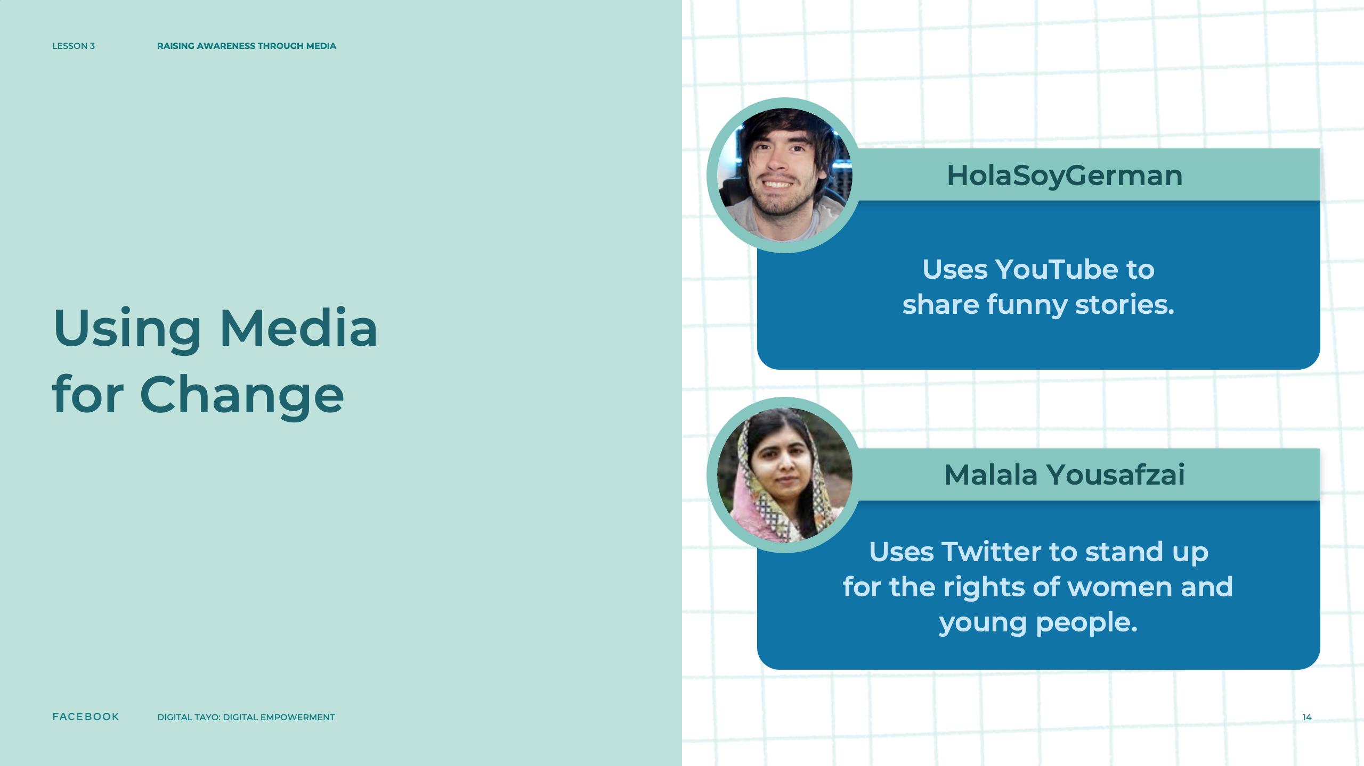
Notes:
Speaker Notes:
Using Media for Change
TELL YOUR STUDENTS
Media is an awesome tool for sharing ideas with others.
For many, digital media platforms are their favorite way to communicate their messages. For instance, HolaSoyGerman uses YouTube to share funny stories with people around the world and Malala Yousafzai uses Twitter to stand up for the rights of women and young people.
Sometimes, young advocates use digital media to target specific problems.
TEACHER’S NOTE
In this segment, you can cite a specific example of a youth icon that speaks about important issues for young people.

Slide 15
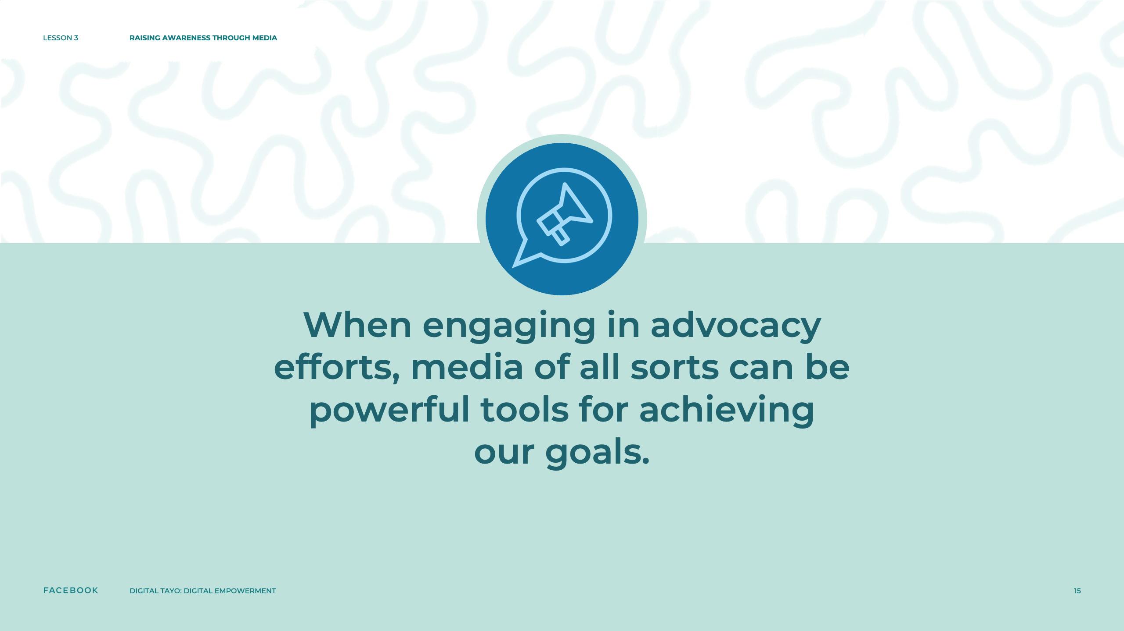
Notes:
Speaker Notes:
VIDEO
On a projection screen at the front of the room, show a recent video example aligned with your/students’ local/regional context to illustrate further how media can be used to foster awareness and advocacy around a particular cause.
TELL YOUR STUDENTS
When engaging in advocacy efforts, media of all sorts can be powerful tools for achieving our goals. In the following activity, you will explore this idea by creating a message and spreading it across various types of media to reach a large audience.

Slide 16

Notes:
Speaker Notes:
ASSIGNMENT
Part 1
TELL YOUR STUDENTS
Find an example of media (e.g., a YouTube video, Facebook post, a picture) that is inspiring and might be a good way to help spread a message about a cause that you care about. You will have 15 minutes to find this content. Afterwards, students will show the group what they found and why they think it is inspiring.
CLASS INTERACTION
Give students 15 minutes to find an example of media that they believe effectively spreads a message about a cause. Afterwards, take 15 minutes and ask each student to briefly describe and/or show the media to the group and discuss why they think it inspiring.
The second portion of this assignment may be completed during the current or second group convening, depending on the time allotted.

Slide 17

Notes:
Speaker Notes:
Part 2
TELL YOUR STUDENTS
Now that we’ve found and discussed an inspiring and effective example of media to promote a cause, it’s time for you to create your own media content around a cause you care about.
Over the next 20 minutes, think of a cause that is important to you and write down your idea for a specific type of media to raise awareness around the cause. This might include:
A text post to communicate your cause and why people should take action
An idea for an image or graphic (or image/graphic itself) to communicate the cause and how others can help support it
An idea for a video to raise awareness and encourage action around the cause
In addition to this idea, please also write down:
At least two possible ways you might spread your media message to increase visibility and awareness of the cause
CLASS INTERACTION
Give students 20 minutes to write down their ideas. Afterward, ask students to share what they wrote with the larger group. Take 15 minutes for discussion.

Slide 18
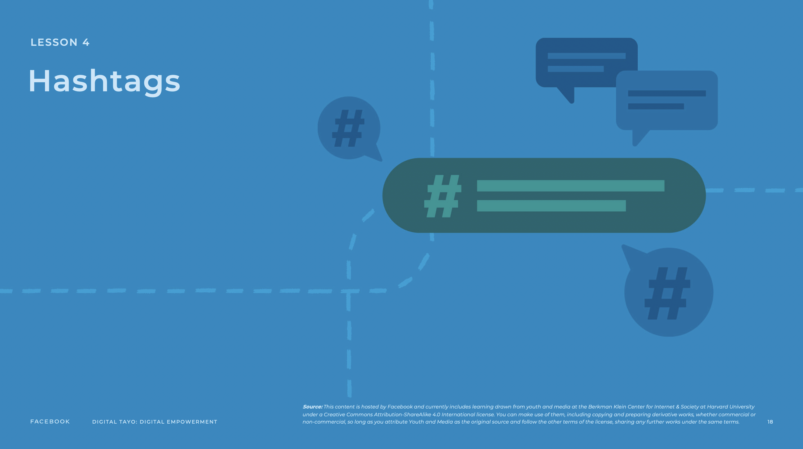
Notes:
Speaker Notes:
LESSON OBJECTIVE
Students will learn how hashtags have been effective in promoting social movements. Students will also identify how hashtags on social media can help raise awareness about an advocacy issue and will develop their own hashtag and methods of promotion for a cause that interests them.
ESTIMATED TIME
1 Hour and 10 Minutes
ESSENTIAL QUESTIONS
How have others made use of hashtags to promote a cause?
How can you use hashtags to raise awareness around an issue?
PREPARATION
Identify a video to demonstrate how media can be used to foster awareness and advocacy relevant to your community.
Students need internet access to complete this lesson.
OPTIONAL: ISTE DIGCITCOMMIT COMPETENCY
ENGAGED: I use technology and digital channels for civic engagement, to solve problems, and to be a force for good in both physical and virtual communities.

Slide 19
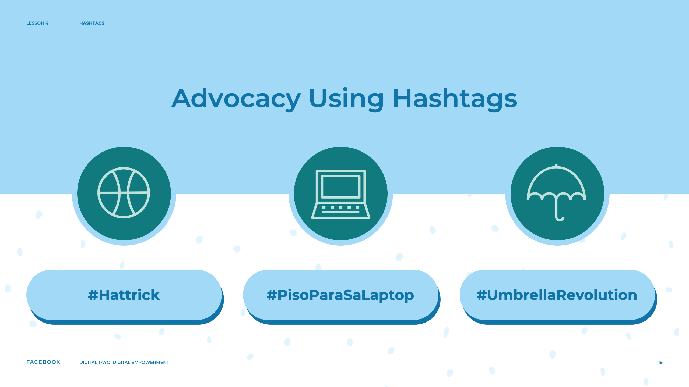
Notes:
Speaker Notes:
Advocacy Using Hashtags
TELL YOUR STUDENTS
While individuals often use specific social media platforms in advocacy campaigns for particular reasons, these platforms share certain characteristics. One helpful common feature is the hashtag. Hashtags allow us to draw attention to our ideas by connecting our posts to other posts on the same topic. For instance, if we wanted to share videos from our recent football game where our striker performed a hat trick, we could include “#football” and “#hattrick” in the description of the video to allow other people looking for football videos to see it. This way, we could increase the chances that professional sports scouts might view our videos.
Hashtags are especially useful for advocacy projects. For instance, Filipino students used the hashtag #PisoParaSaLaptop to ensure they weren’t left behind when the country shifted to distanced learning. With the simple ask that one peso could bring students closer to a laptop, the hashtag was used to raise money for students in need.
The hashtag is a powerful form of social media on a global scale. When the terrorist organization Boko Haram kidnapped 276 girls from their high school in Chibok, Nigeria, people in Nigeria tried to raise awareness around the issue on social media by posting content online with the hashtag “#BringBackOurGirls.” The issue quickly garnered global support, with powerful celebrities and public figures supporting the cause.
There are many other examples of using hashtags for advocacy around the world. For instance, Mexican university students used “#YoSoy132” in the 2012 presidential election, Hong Kong university students rallied around the “#umbrellarevolution” hashtag during the democracy protests of 2014, and Chilean university students used “#MovimientoEstudiantil” to advocate for educational reform.
When you are advocating for a cause, using hashtags is a great way to reach an audience with your ideas. In the following exercise, we will explore the use of hashtags on social media.

Slide 20
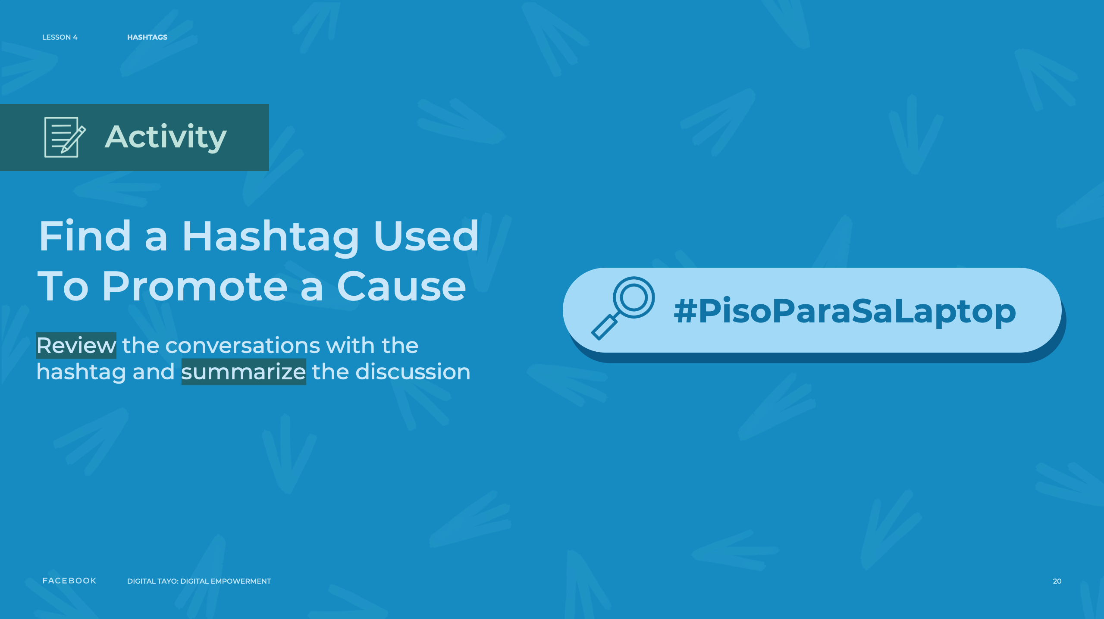
Notes:
Speaker Notes:
ASSIGNMENT
Part 1
CLASS INTERACTION
Organize students into pairs.
TELL YOUR STUDENTS
In teams of two, find a hashtag that has recently been used to promote a cause. Once you find a hashtag, review the conversations taking place and in your team, come up with a short summary of what is being discussed. You will present this summary orally to the rest of the group. You will have 15 minutes to find a hashtag and come up with a summary.

Slide 21
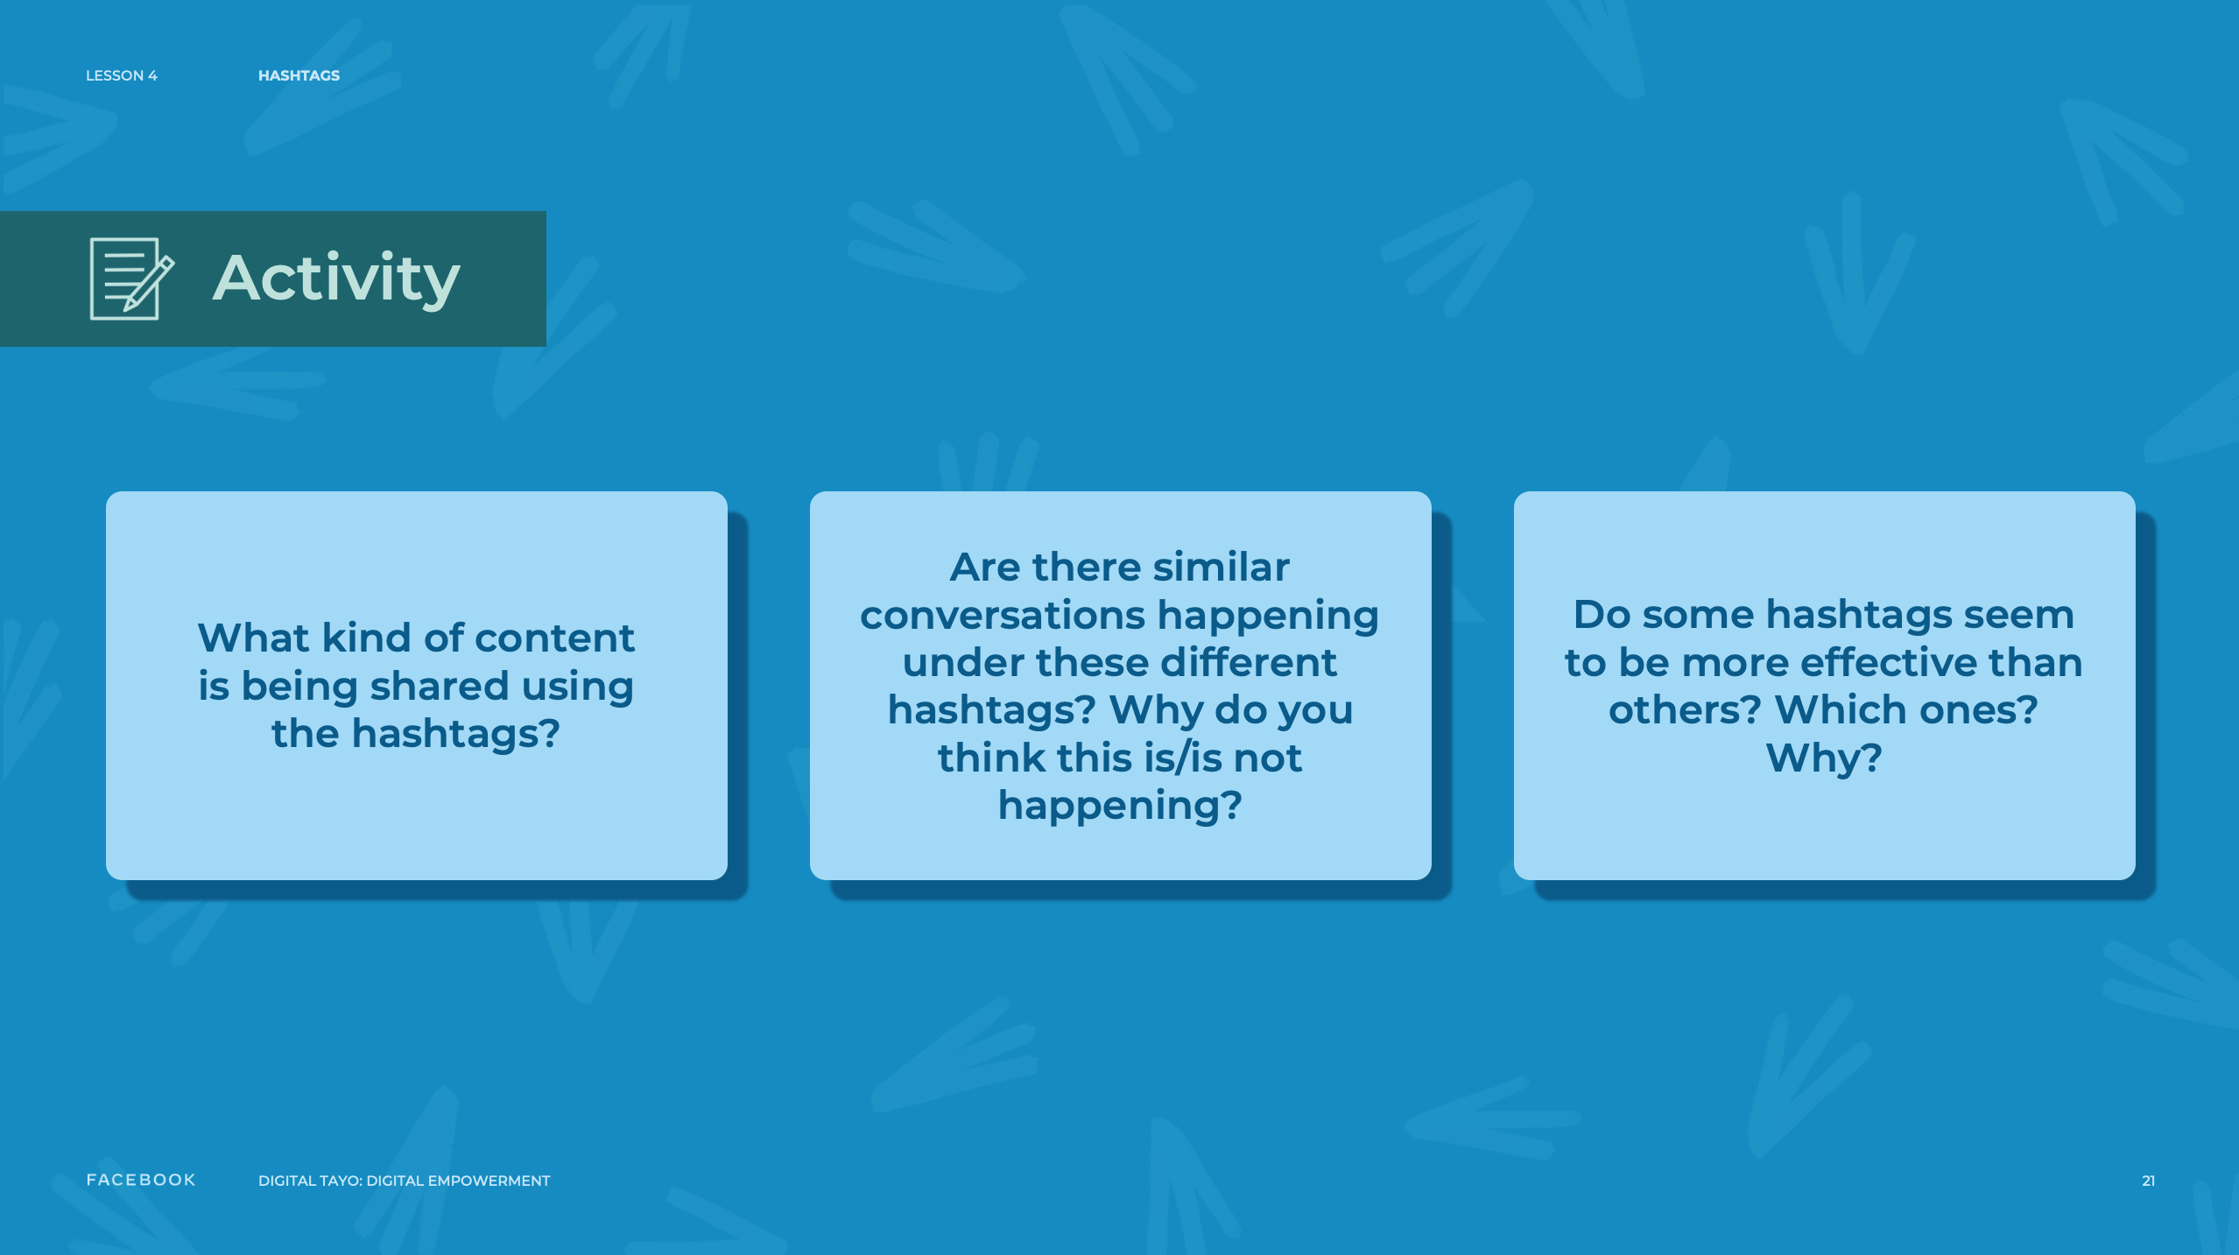
Notes:
Speaker Notes:
CLASS INTERACTION
Give students 15 minutes to work. Once they are finished, allow for 15 minutes for each pair to present their summaries to the group.
ASK YOUR STUDENTS
What kind of content is being shared using the hashtags?
Are there similar conversations happening under these different hashtags? Why do you think this is/is not happening?
Do some hashtags seem to be more effective (e.g., more likely to be reposted) than others? Which ones? Why?

Slide 22
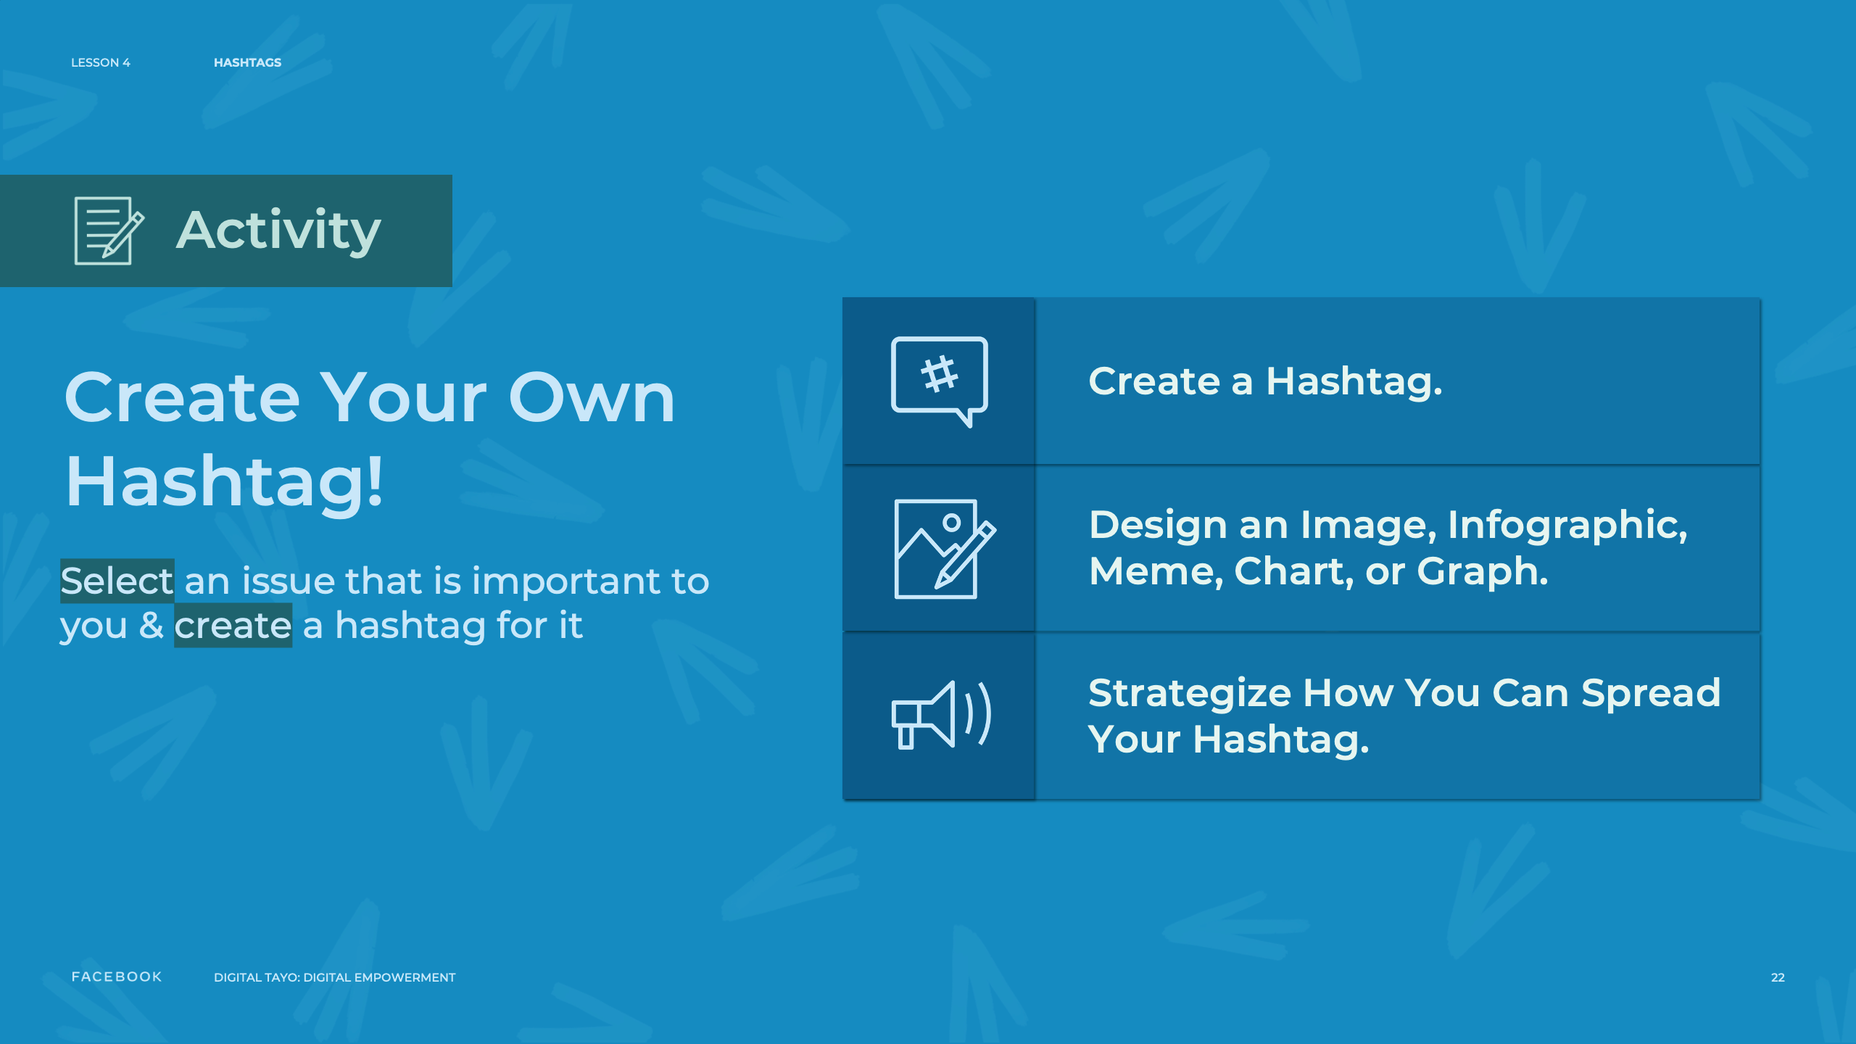
Notes:
Speaker Notes:
Part 2
TELL YOUR STUDENTS
Now, come up with an issue that is important to your pair and:
Create a hashtag for it.
Design an image, infographic, meme, chart, or graph to promote your hashtag.
With your partner, discuss various ways that you can spread your hashtag through a network. What are some successful strategies we learned from examining other hashtags?
You will have 30 minutes to complete this exercise.
CLASS INTERACTION
Give students 30 minutes to engage in this exercise with their partner. Afterward, allow 20 minutes for pairs to discuss, with the larger group, their hashtag, accompanying visual and ideas for spreading the hashtag.
TEACHER’S NOTE
When you click a hashtag, you’ll see a feed of posts that include that hashtag. You may also see some related hashtags at the top of the page.
Please keep in mind:
A hashtag must be written as a single word, without any spaces.
You can include numbers in a hashtag, but punctuation and special characters (like $ and %) won't work.
You can search for a hashtag using the search bar at the top of any page.
You'll see posts that have been shared publicly.

Slide 23
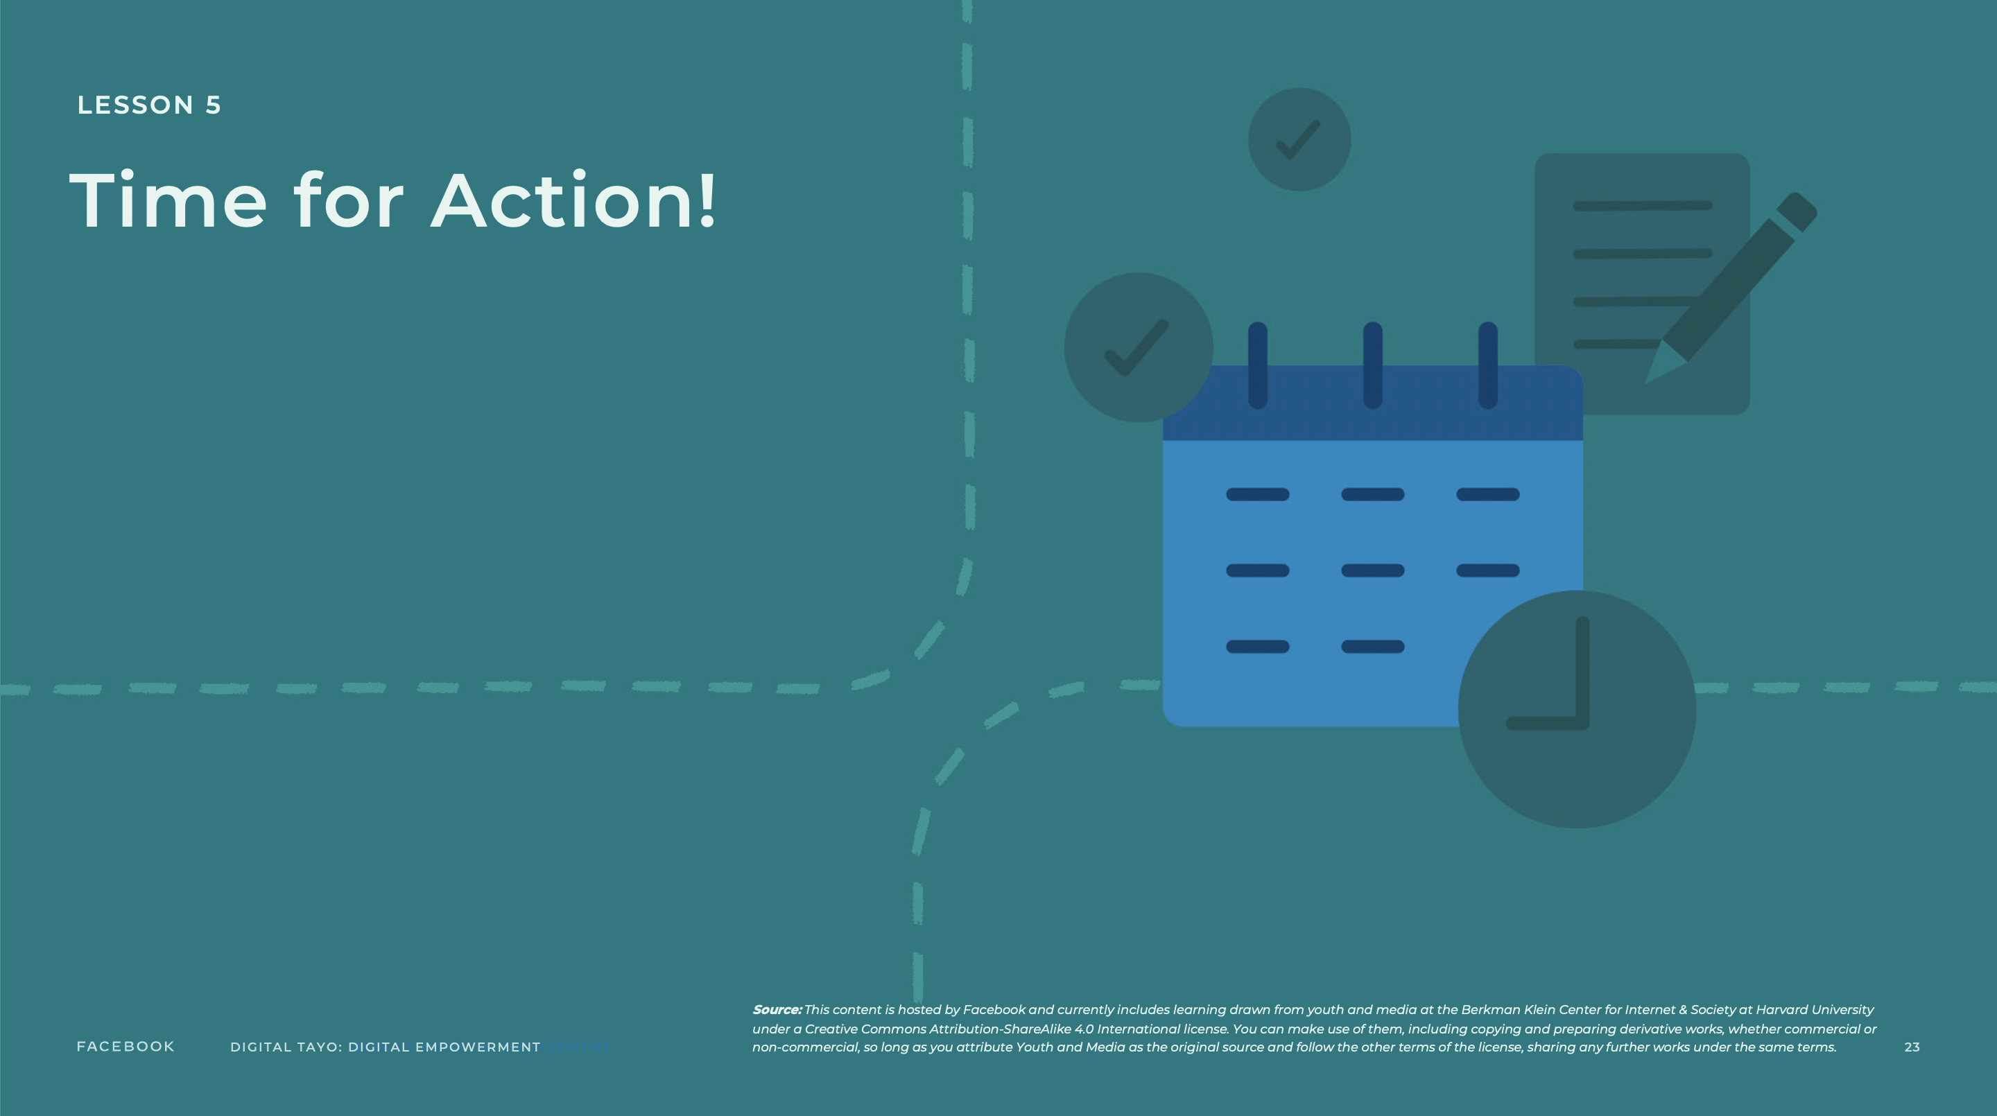
Notes:
Speaker Notes:
LESSON OBJECTIVE
Students will learn how to develop an initial plan for their own advocacy campaign.
ESTIMATED TIME
1 Hour and 25 Minutes
ESSENTIAL QUESTIONS
Why does taking action around issues matter?
How can digital technologies be used to help drive change?
MATERIALS
Advocacy Campaign Handout
PREPARATION
Print out a handout for every student.
Identify a video to demonstrate how media can be used to foster awareness and advocacy relevant to your community.
Students need internet access to complete this lesson.
OPTIONAL: ISTE DIGCITCOMMIT COMPETENCY
ENGAGED: I use technology and digital channels for civic engagement, to solve problems, and to be a force for good in both physical and virtual communities.

Slide 24
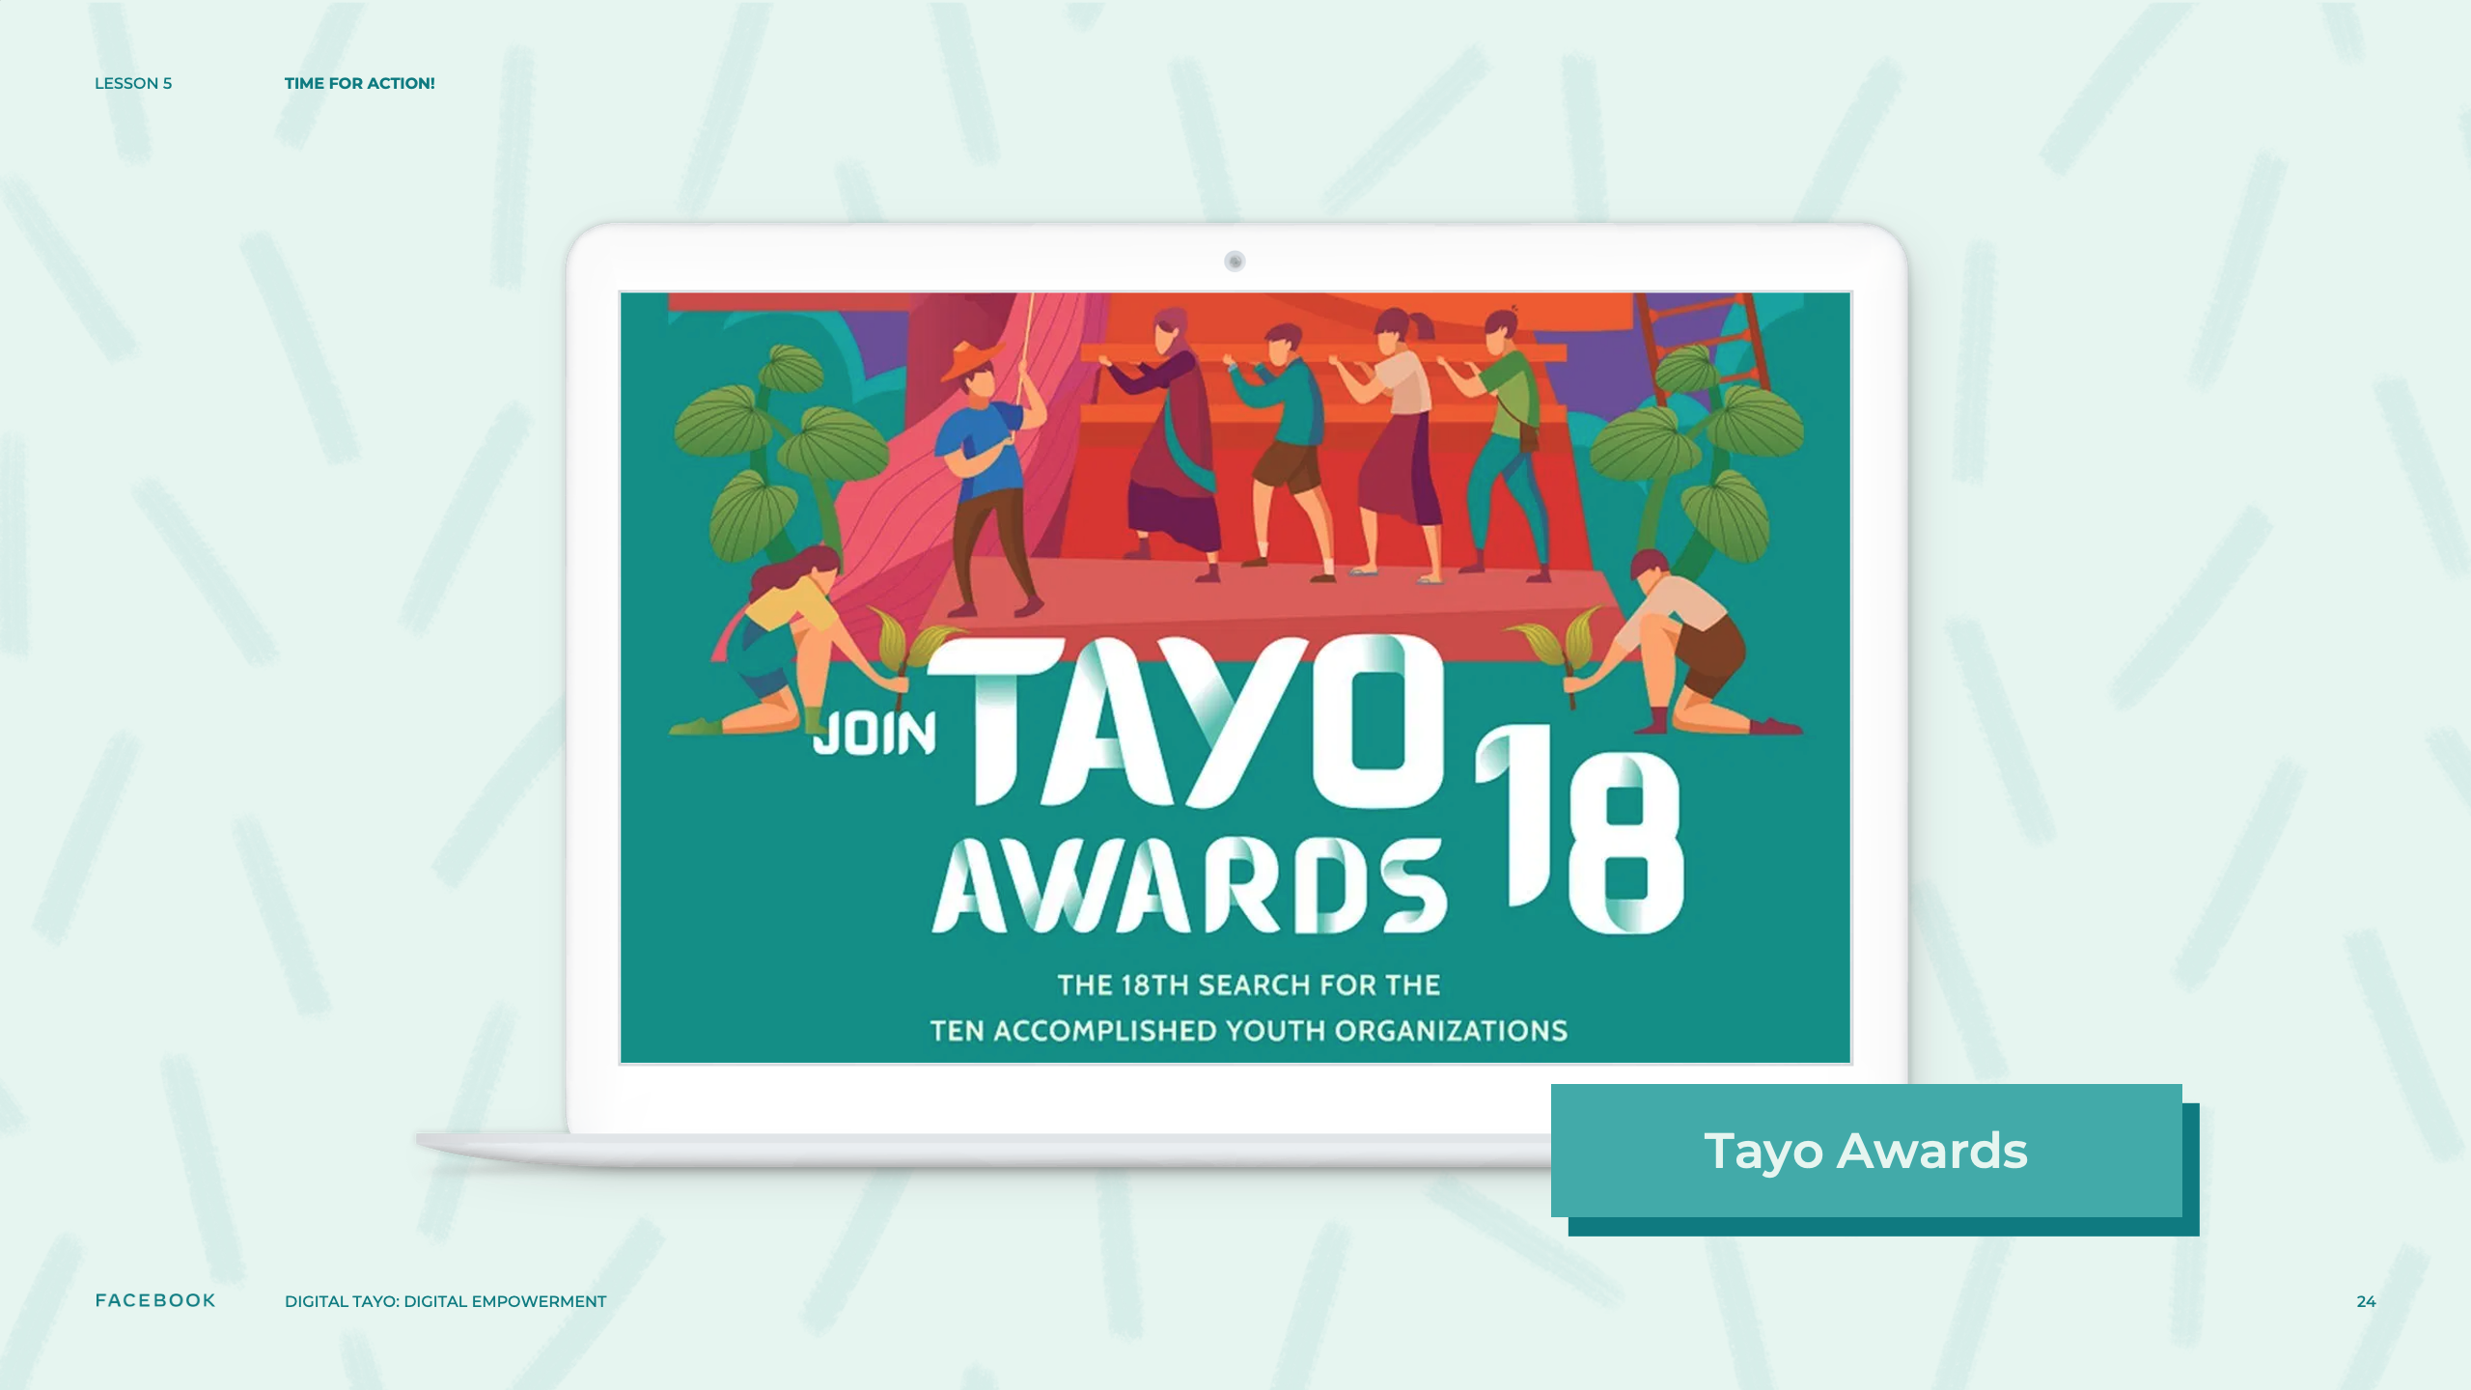
Notes:
Speaker Notes:
A Plan for Change!
TELL YOUR STUDENTS
In some of the other learning experiences connected to civic and political engagement that we have completed together, we explored different skills and ideas that can be useful for becoming advocates for change.
We have identified issues that affect your communities and learned about specific networking and media tools to implement positive change.
Now, it is time to bring these ideas together and plan your own advocacy campaign from start to finish!
CLASS INTERACTION
Optional: Present a current and youth-relevant advocacy campaign aligned with your/students’ local/regional context. The websites TAYO Awards, We The Youth Vote, and Youth Strike 4 Climate Philippines might serve as sources of inspiration if you are uncertain which campaign to select. Feel free to project the campaign’s website on a projection screen as you describe it.

Slide 25
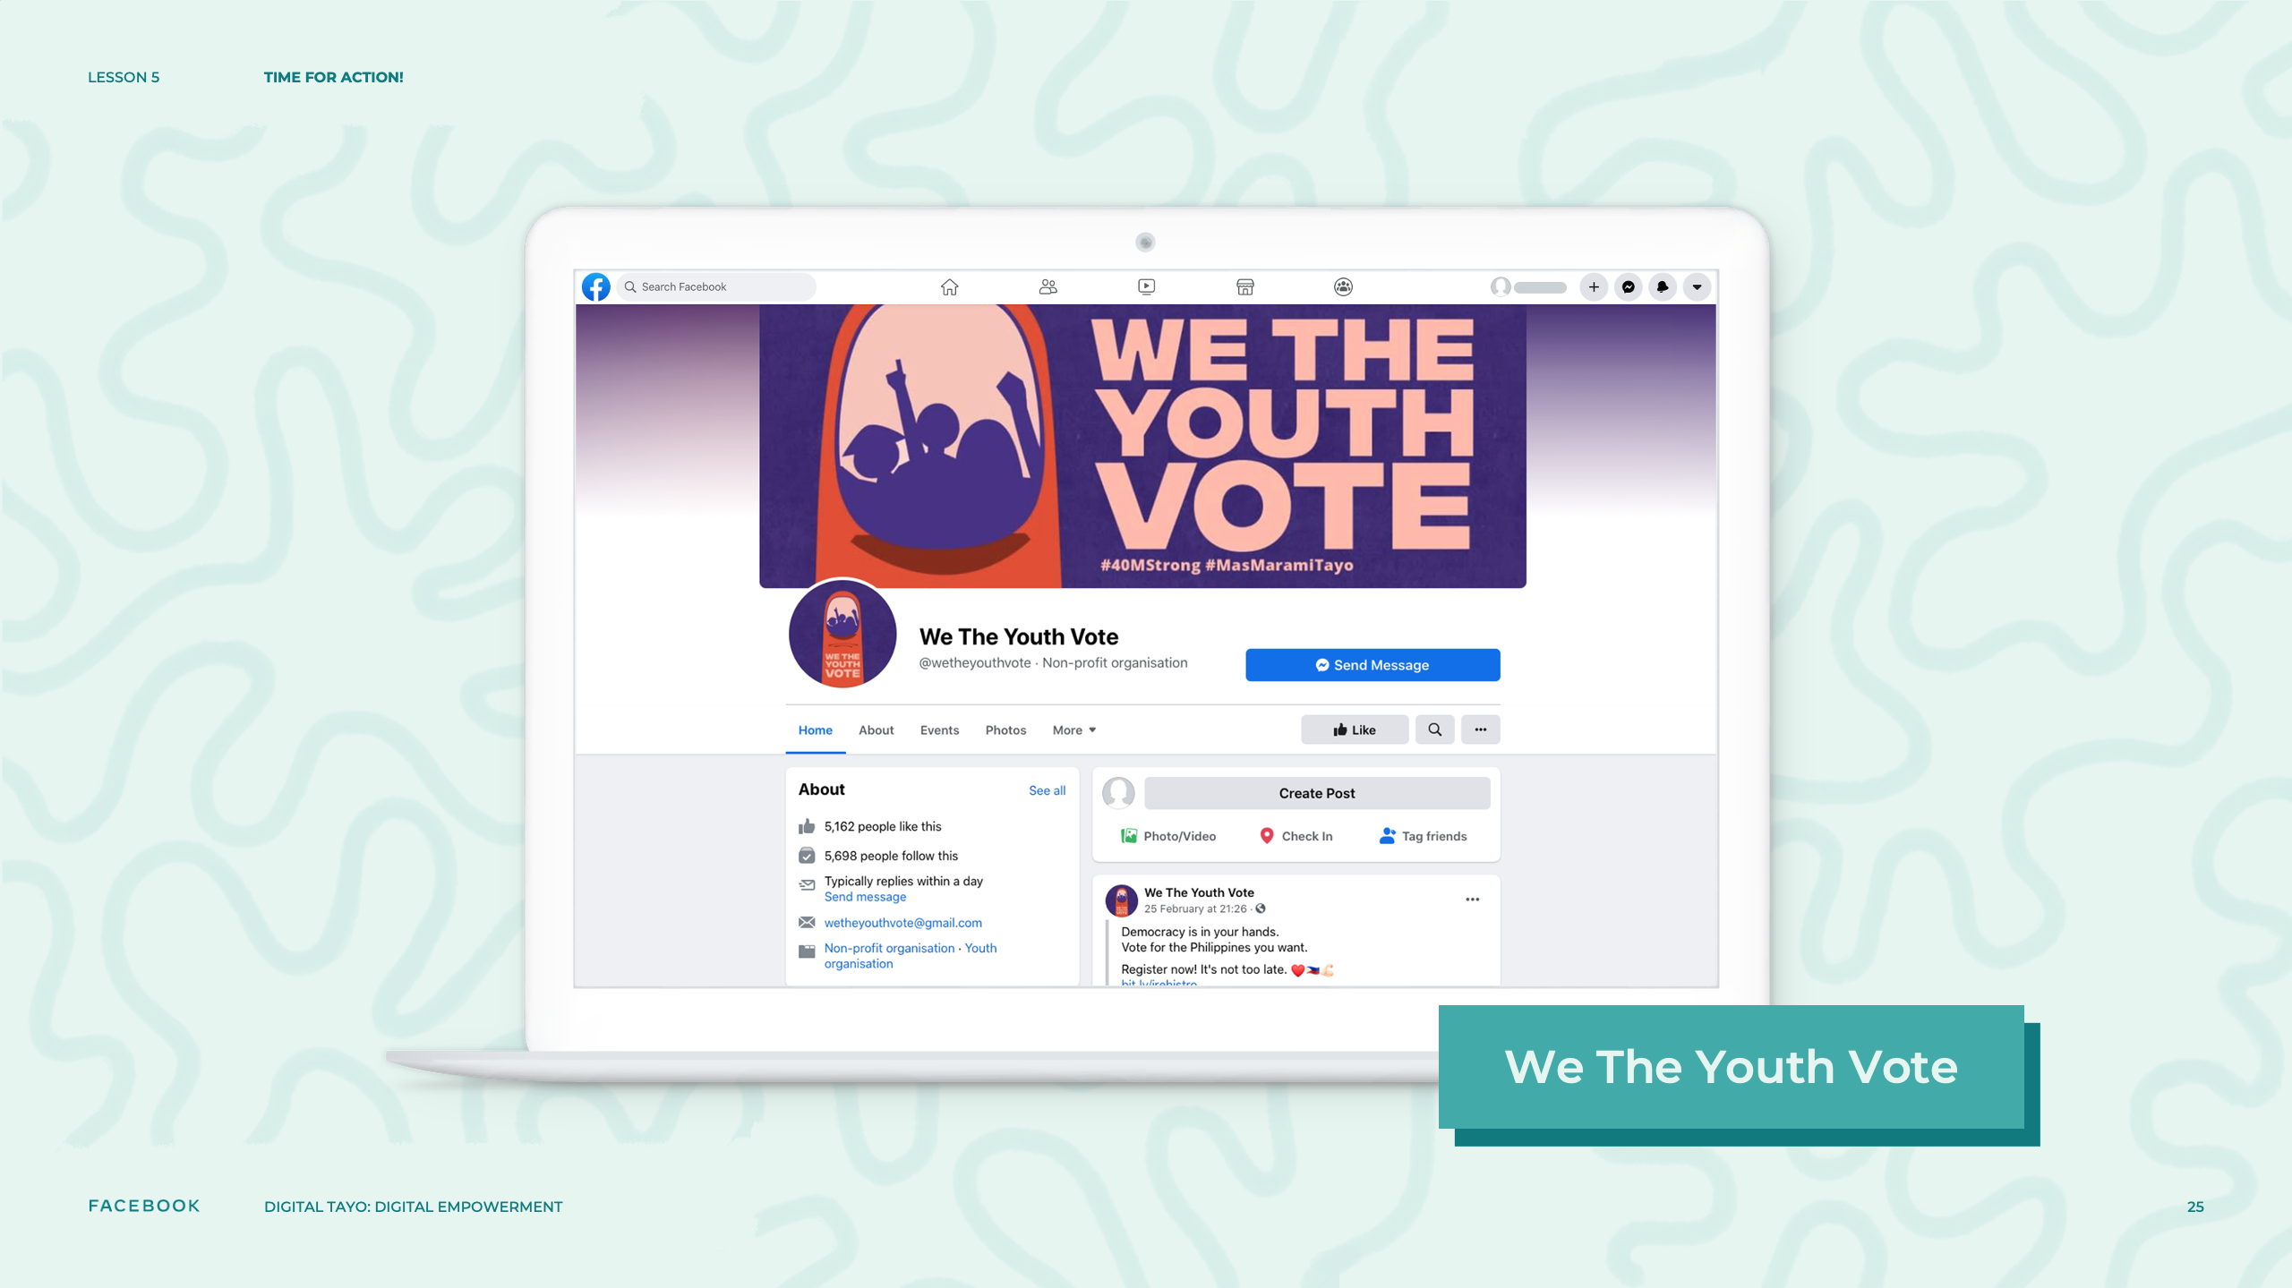
Notes:
Speaker Notes:
CLASS INTERACTION
Optional: Present a current and youth-relevant advocacy campaign aligned with your/students’ local/regional context. The websites TAYO Awards, We The Youth Vote, and Youth Strike 4 Climate Philippines might serve as sources of inspiration if you are uncertain which campaign to select. Feel free to project the campaign’s website on a projection screen as you describe it.

Slide 26
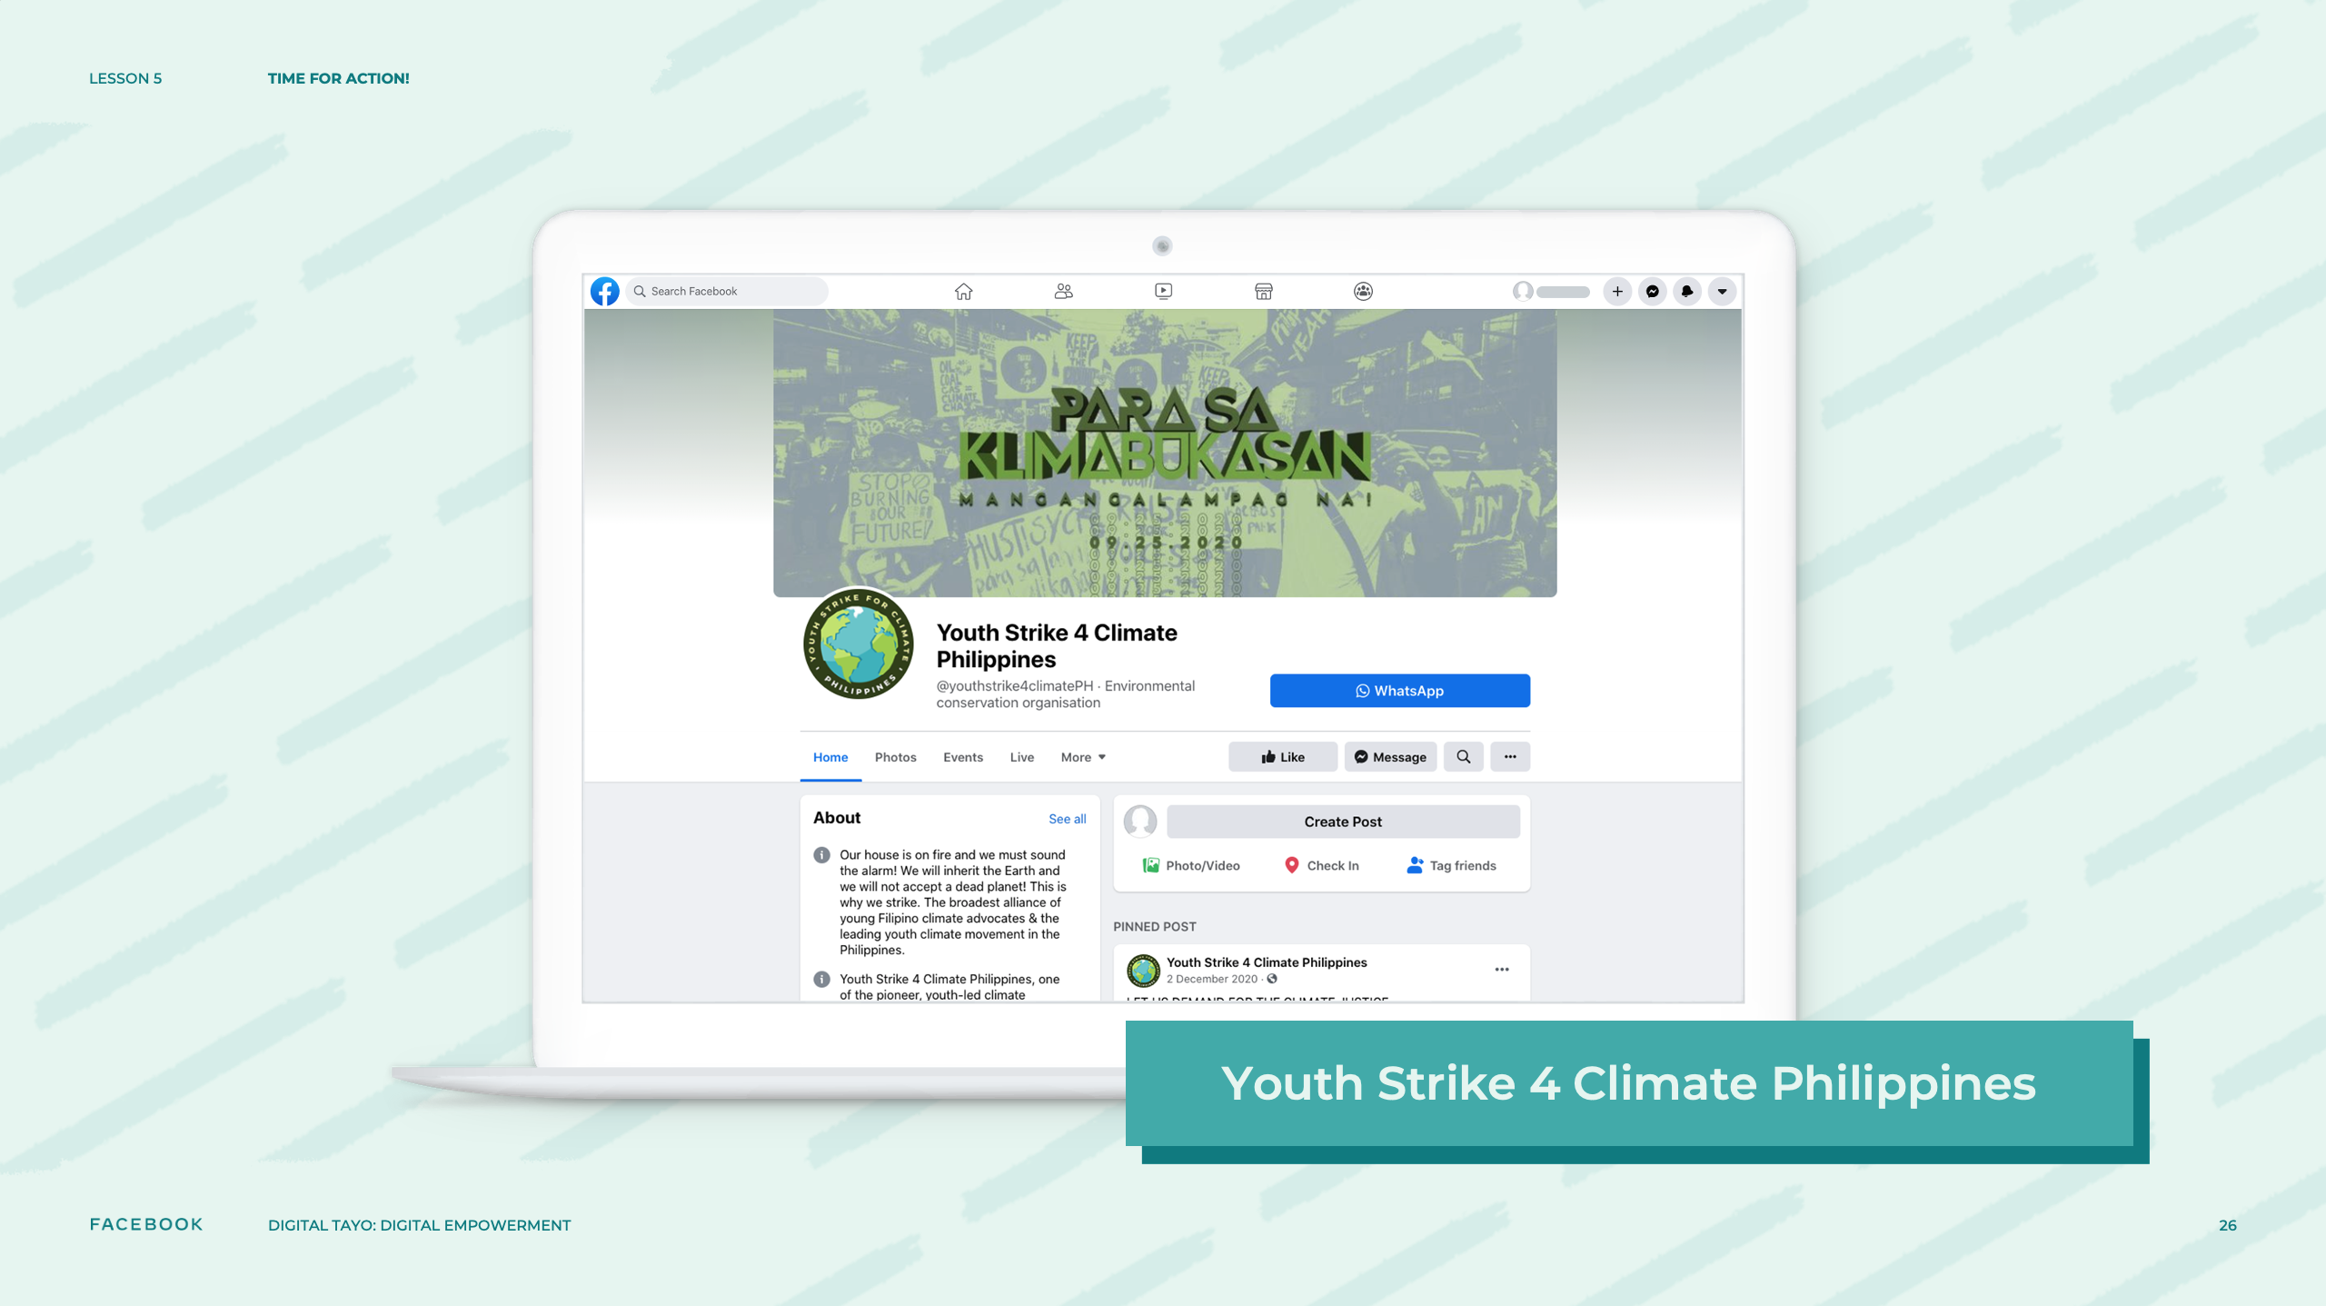
Notes:
Speaker Notes:
CLASS INTERACTION
Optional: Present a current and youth-relevant advocacy campaign aligned with your/students’ local/regional context. The websites TAYO Awards, We The Youth Vote, and Youth Strike 4 Climate Philippines might serve as sources of inspiration if you are uncertain which campaign to select. Feel free to project the campaign’s website on a projection screen as you describe it.

Slide 27
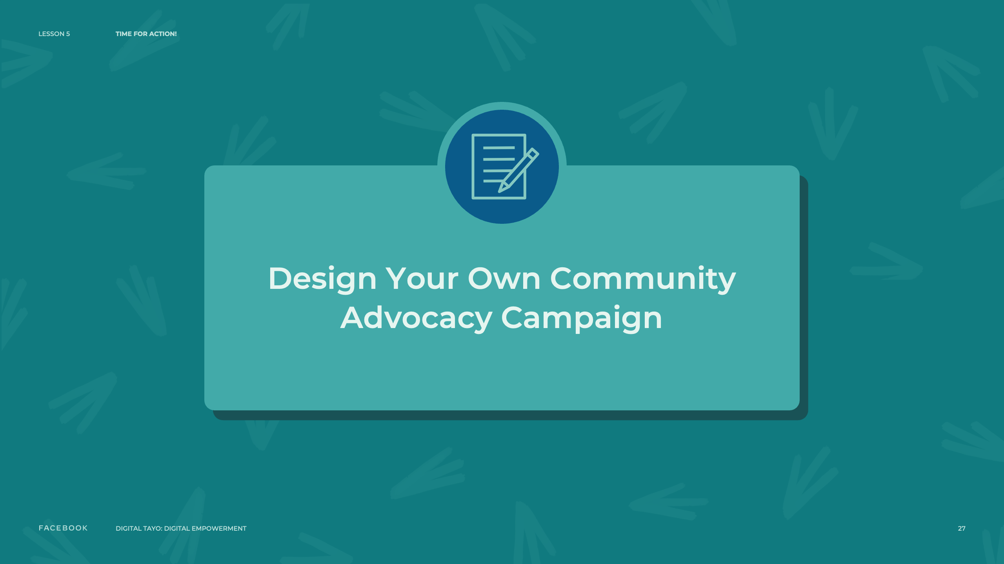
Notes:
Speaker Notes:
ASSIGNMENT
TELL YOUR STUDENTS
Create a write-up outlining an advocacy campaign you would like to run in your community. You can include the text you wrote in some of the previous learning experiences. For example, you might incorporate information about the issue that you want to address or an explanation about why a pop culture character you have chosen for your campaign aligns with your advocacy goals. Work together in small groups to brainstorm and develop your campaign plan. You will have 45 minutes to design your campaign.

Slide 28
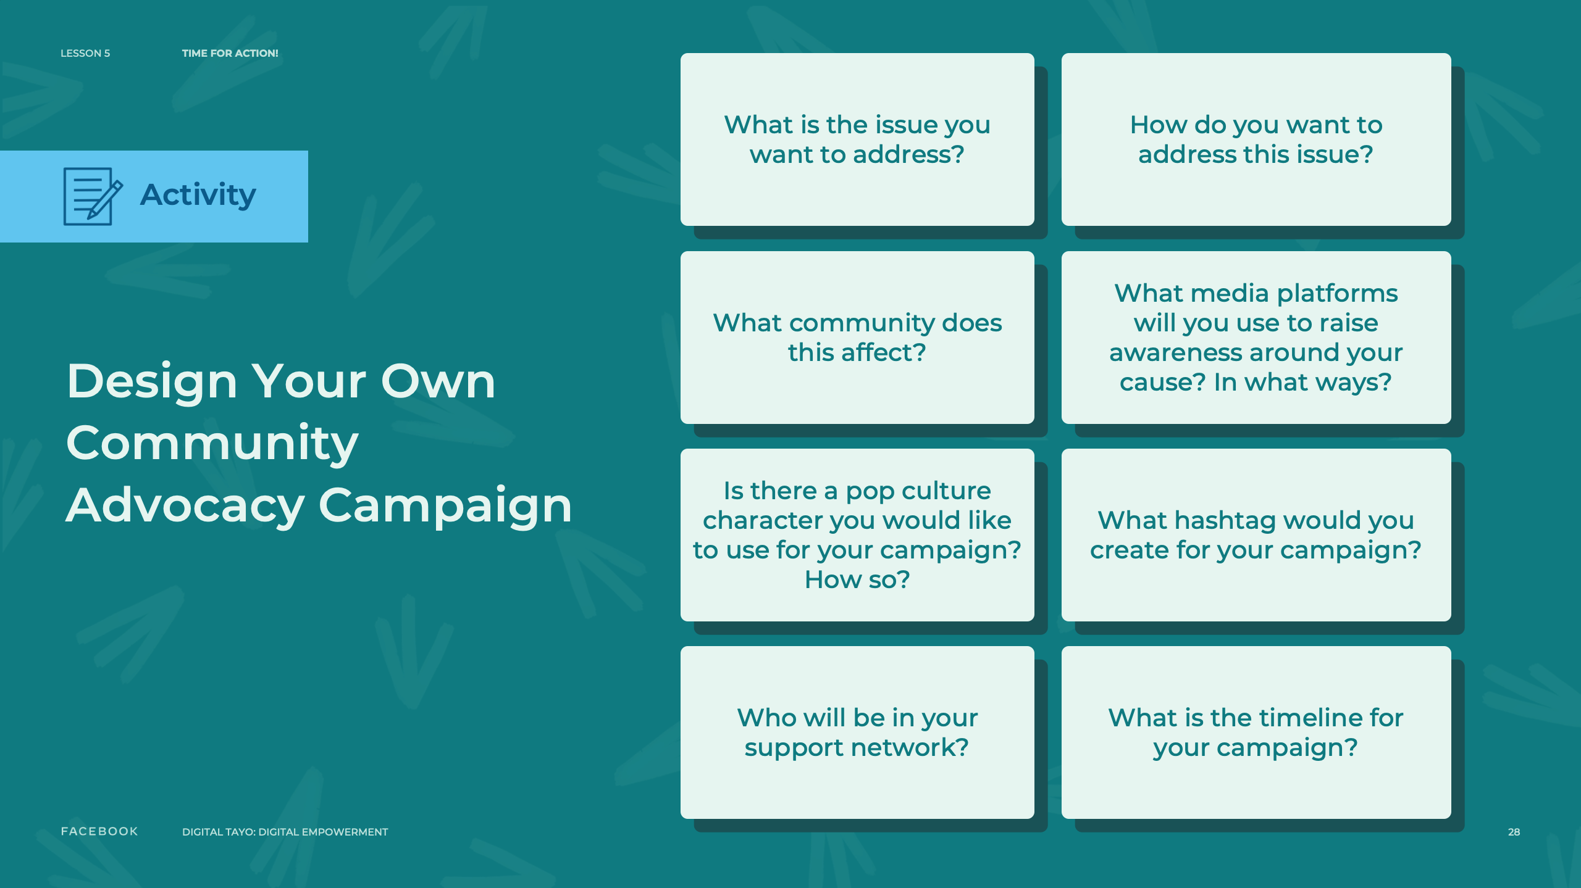
Notes:
Speaker Notes:
TELL YOUR STUDENTS
Please answer the following questions:
What is the issue you want to address?
What community does this affect?
How do you want to address this issue?
What media platforms will you use to raise awareness around your cause? In what ways?
Is there a pop culture character you would like to use for your campaign? How so?
Who will be in your support network?
What hashtag would you create for your campaign?
What is the timeline for your campaign?
Feel free to develop your ideas on the Advocacy Campaign Worksheet or on a separate piece of paper.
Pass out Advocacy Campaign Worksheet to students.

Slide 29
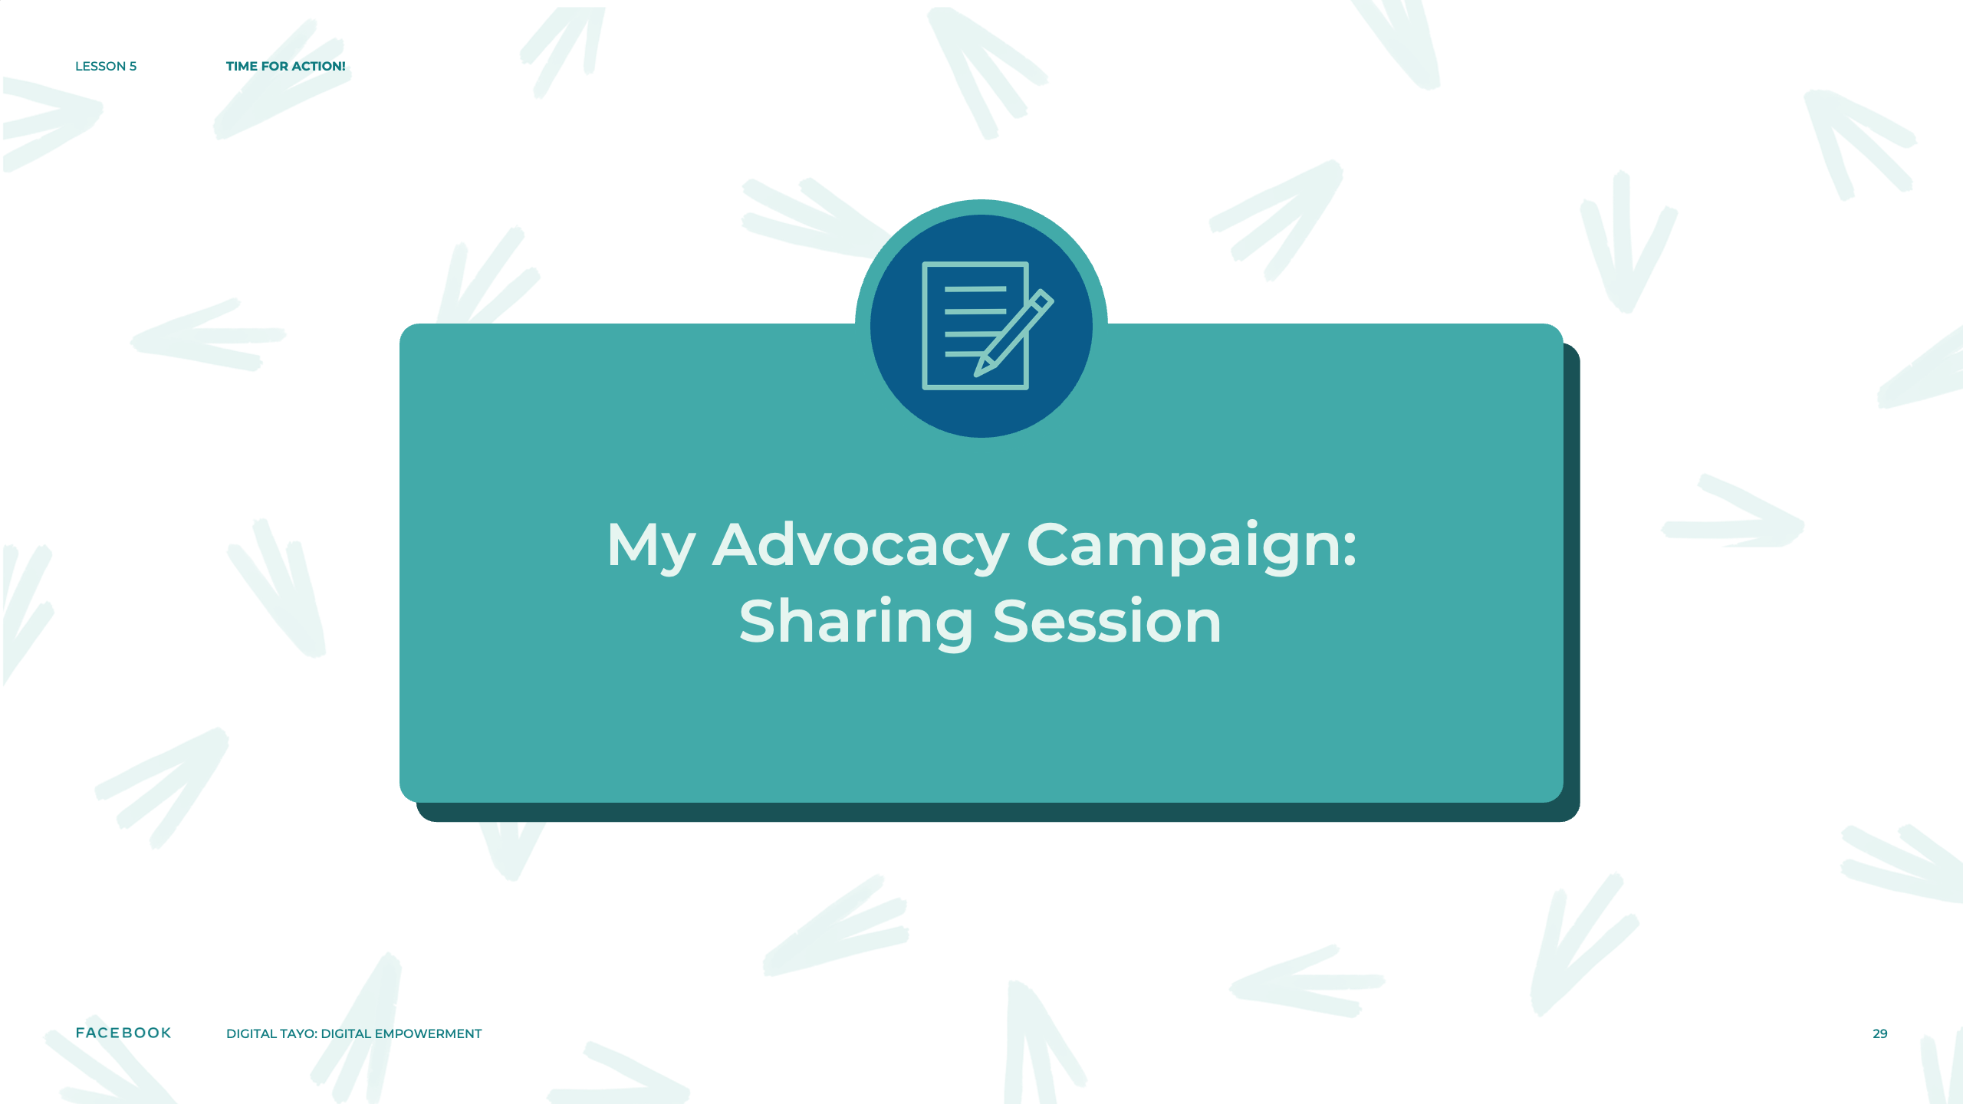
Notes:
Speaker Notes:
CLASS INTERACTION
Now, in pairs, you will share your advocacy campaign write-up. Talk with your partner about the aspect of your campaign that you are the most excited about!
Allow students 20 minutes to share their campaign.

Slide 30

Notes:
Speaker Notes:
LESSON OBJECTIVE
Students will:
Sort a list of values in order of importance.
Reflect on how the most important values impact their lives and their future plans.
ESTIMATED TIME
45 Minutes
ESSENTIAL QUESTION
How do your values affect your daily actions and your plans for the future?
MATERIALS
“Exploring Your Personal Values” Handout
Writing Materials
PREPARATION
Take a moment to identify the three most important values to you listed on the handout. Why are these values so important to you? How do they influence your daily life and your long-term plans?
OPTIONAL: ISTE DIGCITCOMMIT COMPETENCY
ENGAGED: I use technology and digital channels for civic engagement, to solve problems, and to be a force for good in both physical and virtual communities.

Slide 31

Notes:
Speaker Notes:
TELL YOUR STUDENTS
Your personal values are core to your purpose in life. The things you believe in and value deeply are likely to shape the aims that give your life purpose. With that in mind, take a few minutes to complete the handout that asks you to sort a list of values by how important each is to you.

Slide 32
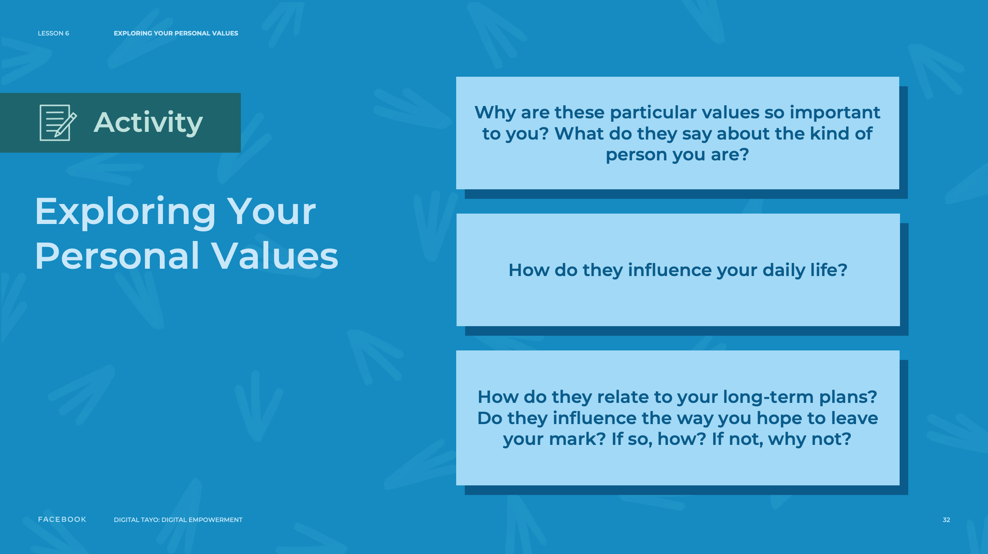
Notes:
Speaker Notes:
TELL YOUR STUDENTS
Give each student a handout and have them complete it on their own.
Once students have finished, have them write answers to the following questions about the items that they placed a “1” next to (these questions are also listed at the bottom of the handout):
Why are these particular values so important to you? What do they say about the kind of person you are?
How do they influence your daily life?
How do they relate to your long-term plans? Do they influence the way you hope to leave your mark? If so, how? If not, why not?
CLASS INTERACTION
Give students the opportunity to share either their writing or their thoughts about this process with each other or with the whole class, if they feel comfortable doing so.

Slide 33

Notes:
Speaker Notes:
ASSIGNMENT
(in class or homework)
Ask students to reflect on whether this exercise confirmed their sense of purpose or, if they aren’t sure of their purpose, did it give them any clues or insight into what their purpose might be?
Reflection After the Practice
How did students respond to this practice? Did they find it helpful in helping them decide what their purpose might be?
Source: The Purpose Challenge Toolkit was created by Dr. Kendall Cotton-Bronk in partnership with the Greater Good Science Center and Prosocial. kendallcottonbronk.com
For more information, visit purposechallenge.org.
ggie.berkeley.edu/practice/exploring- your-personal-values/#tab_2

Slide 34
Notes:
Speaker Notes:
The lessons and activities in this section help students participate in public matters and advocate for issues they care about. Skills addressed: civic and political engagement, content production, and law.

